Slide 1
Application Modernization
Application Modernization Series
Chatchai Kongmanee
Specialist Solution Architect
Red Hat, Thailand

Slide 2
Application Modernization Series
Roadmap
Introduction to Container
DevOps and CI/CD
What & Why Container?
Docker
Demo: Build App & DB with Docker
DevOps and CI/CD Concept
Everything as-a-Code
Demo: Build and Deploy with CI/CD Tool
Session 4
25 Mar 2021 15:00
(45 mins - 1 hour)
Session 2
11 Mar 2021 15:00
(45 mins - 1 hour)
Session 1
4 Mar 2021 15:00
(45 mins - 1 hour)
Session 3
18 Mar 2021 15:00
(45 mins - 1 hour)
Application Modernization
Introduction to Container Orchestration Platform
How to containerize existing App?
Demo: Application Migration Tool, New Framework for Container
What & Why Container Orchestration Platform?
Basic concept of Application Deployment on Container Orchestration Platform with Demo

Slide 3













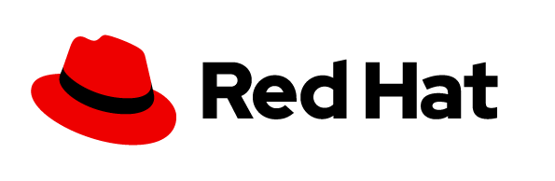
DISRUPTION IS A MATTER OF WHEN NOT “IF”
Just ask anyone who has been disrupted - Did they see it coming?

Slide 4
WHY OPTIMIZE AND MODERNIZE EXISTING APPLICATIONS?
Performance
Maintainability
Security Concerns
New requirements
Technical debt
Integrate old and new
Delivery too slow
Supportability
Talent
Portability
Need to move workloads to cloud
License models & cost
Notes:
WHY OPTIMIZE AND MODERNIZE EXISTING APPLICATIONS? (2mins MAX!!!!)
(click through and give an example each)

Slide 5


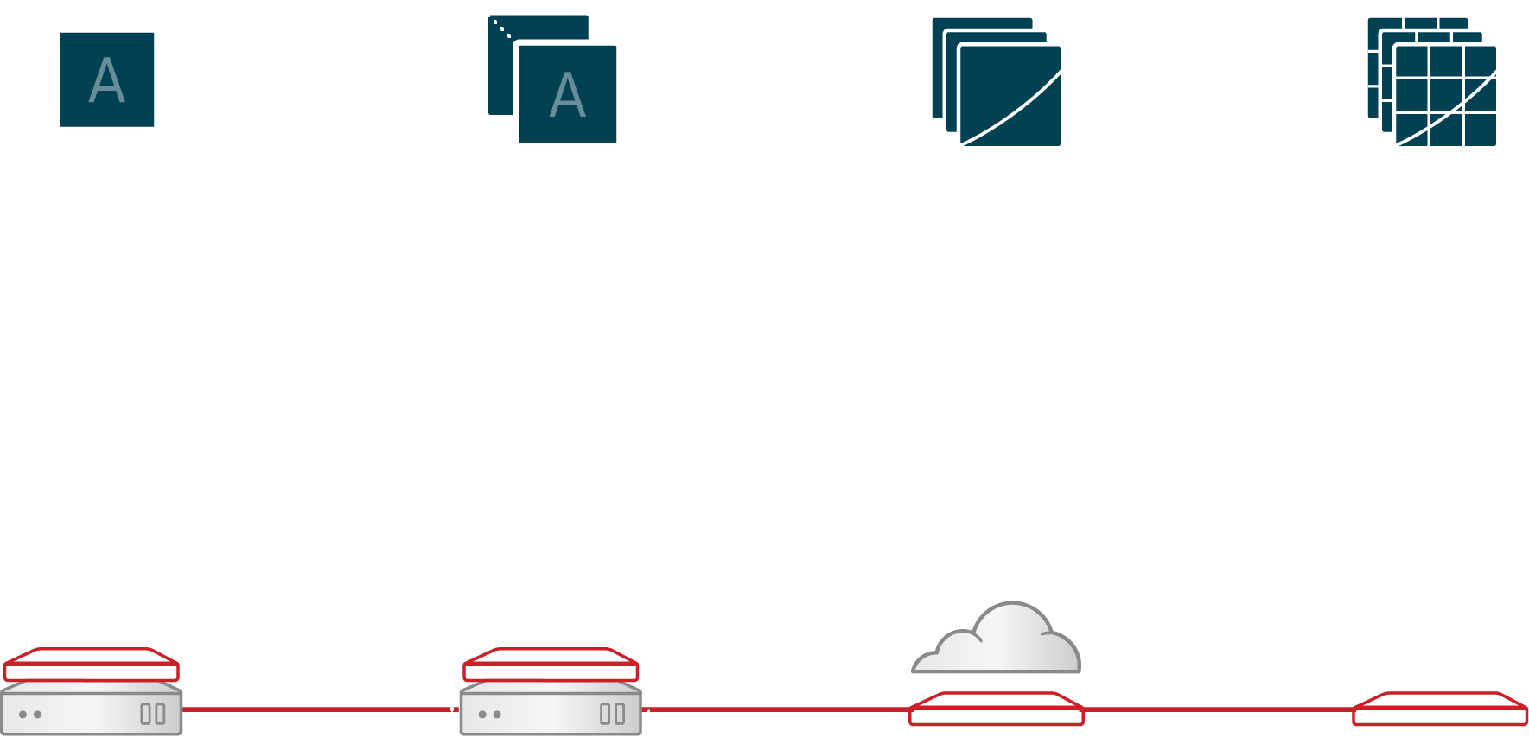



TYPICAL CUSTOMER LANDSCAPE TODAY
Where the journey starts...
RUN Brownfield
GROW
TRANSFORM Greenfield
PHYSICAL
VIRTUAL
PRIVATE & PUBLIC CLOUD
Complex & heterogeneous
Inconsistent automation & governance
Lack of common
standards
Notes:
TYPICAL CUSTOMER LANDSCAPE
Containers, microservices, reactive, serverless

Slide 6
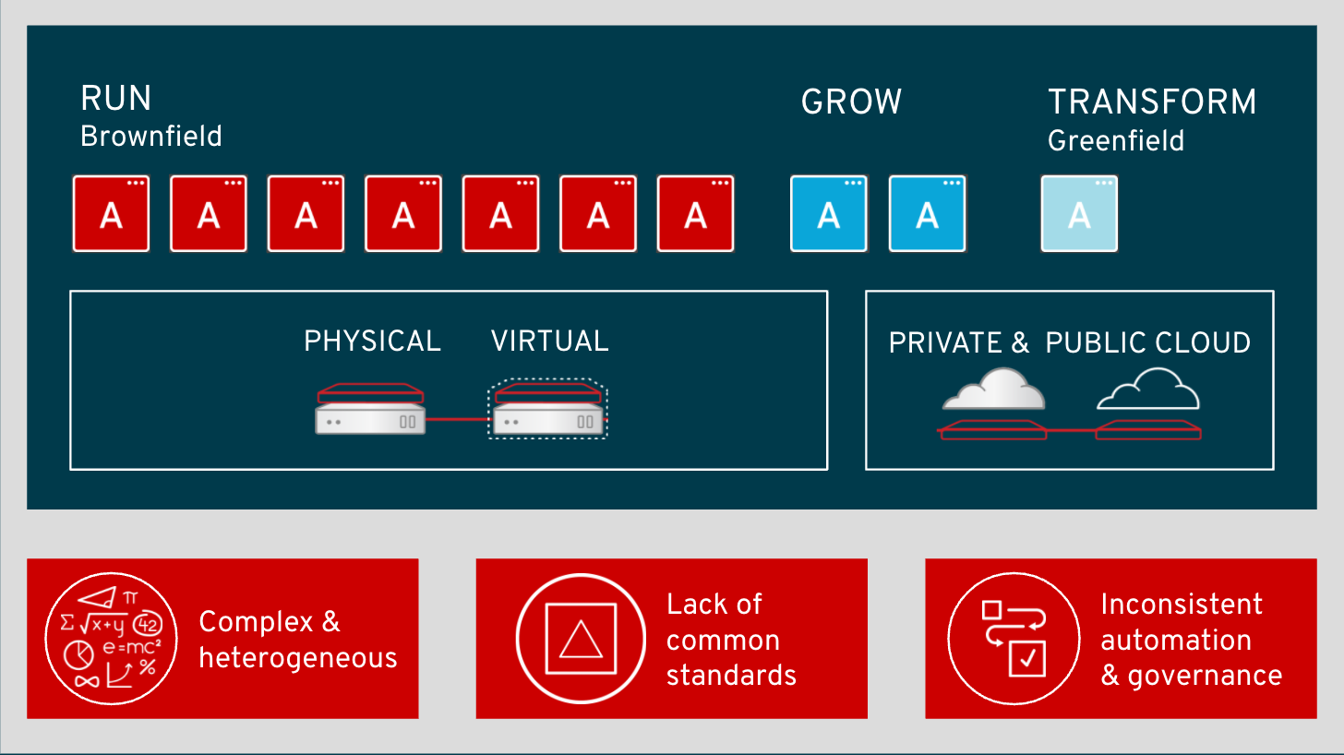
NOW WHAT DO YOU DO?
How do you cater for both?
MODERNIZE EXISTING APPS
DEVELOP NEW APPLICATIONS
THE MODERN WAY
Without
adding more complexity and inconsistencies?
Notes:
NOW WHAT DO YOU DO?
Now what do you do? You know they need to modernize existing applications,
(CLICK)
and you would like to start developing new applications the modern way, maybe with an application runtimes like Spring boot, node.js or fully cloud native leveraging cloud and containers.
(CLICK)
But how can you do that without adding more complexity and inconsistencies?

Slide 7
Develop New Applications The Modern Way

Slide 8
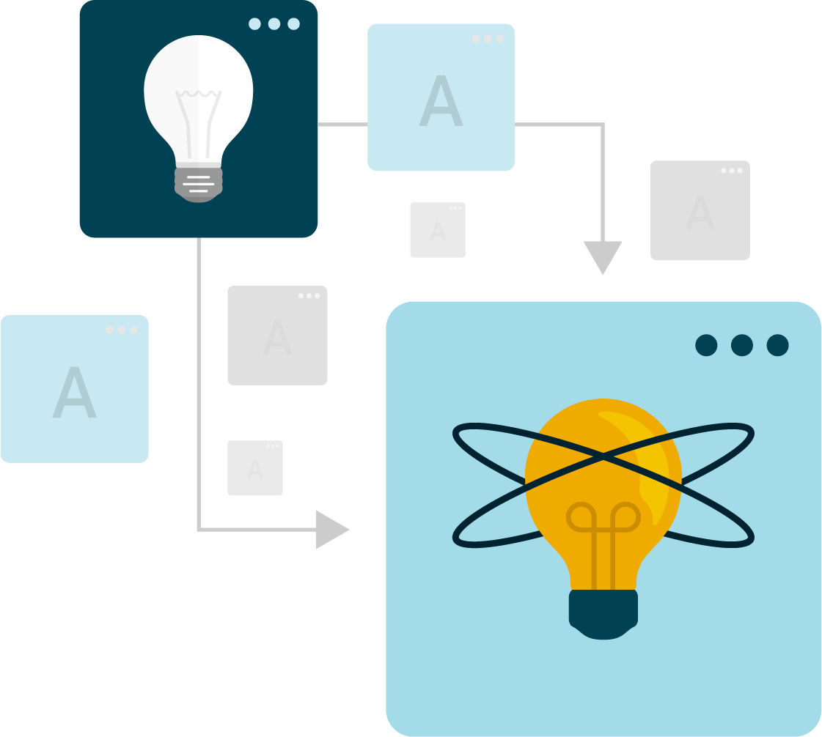
How to modernize application delivery
The following activities guide our model for accelerating software delivery:
Build a cloud capability
Deliver your applications into your cloud
Automate your delivery pipeline
Empower delivery teams with end-to-end responsibility over their code
Organize your delivery teams and code into smaller units
‹#›

Slide 9






Standardize Practices
BUILD
TEST
DEPLOY
Self-service Provisioning
Consistent
environments
Automated
build & deploy
CI/CD pipelines
Configuration management
App logs & metrics
CODE
REVIEW
MONITOR
SPRING & JAVA EE
MICROSERVICES
FUNCTIONS
LANGUAGES
DATABASES
APPLICATION SERVICES
LINUX
WINDOWS*

Slide 10
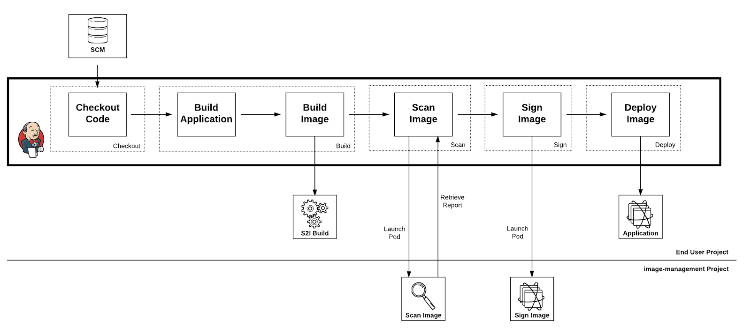
CI/CD
‹#›

Slide 11
Build Reusable Processes
Onboarding
Give developers, testers and operations teams permission
Create namespaces
Inject default configuration and templates
Multiple Environments
Be able to deploy multiple branches at the same time
Configuration
Standard way to inject config maps
Secrets
Integration with external secret store (i.e Hashicorp Vault or CyberArk)
‹#›

Slide 12
Build Reusable Processes
Logging
Splunk Integration
Filebeats
Logstash
Log Forwarding API
etc…
Metrics
User defined metrics in prometheus
Monitoring agent integration
Failover Patterns
‹#›

Slide 13
Build Application Patterns
Build Base Images
Mutual TLS (mTLS)
SSO
Caching
Cloud-Native Runtimes
‹#›

Slide 14

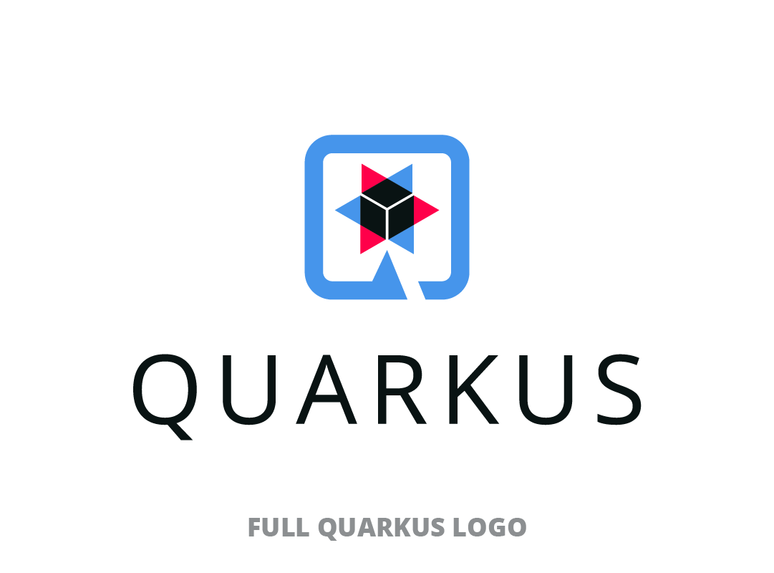
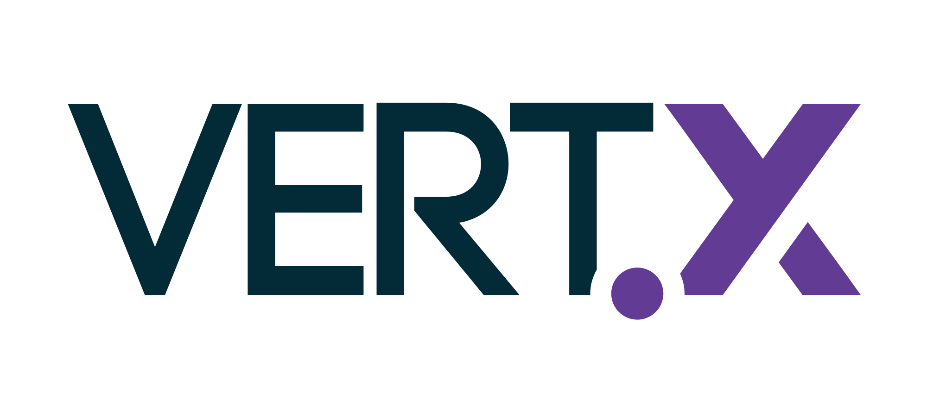




CLOUD-NATIVE RUNTIMES

Slide 15




An Open Source
stack to write Java apps
Cloud Native
Microservices
Serverless
Notes:
Quarkus is an open source stack to write Java apps.
It targets not the monoliths of the past,
But instead targets what developers are doing today: writing cloud native microservices and designing serverless apps that are deployed to cloud infrastructure like Kubernetes and OpenShift and take advantage of the underyling platform to do amazing things.

Slide 16
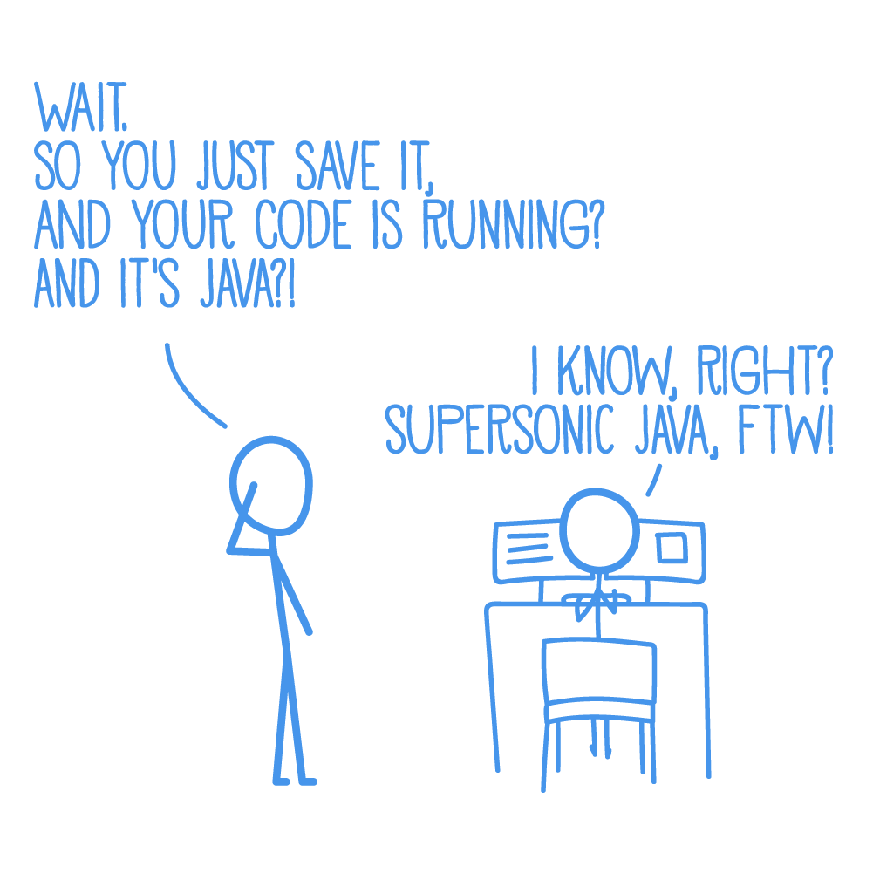
Introduction to Quarkus
Benefit No. 1: Developer Joy
A cohesive platform for optimized developer joy:
Zero config, live reload in the blink of an eye
Based on standards, but not limited
Unified configuration
Streamlined code for the 80% common usages, flexible for the 20%
No hassle native executable generation

Slide 17
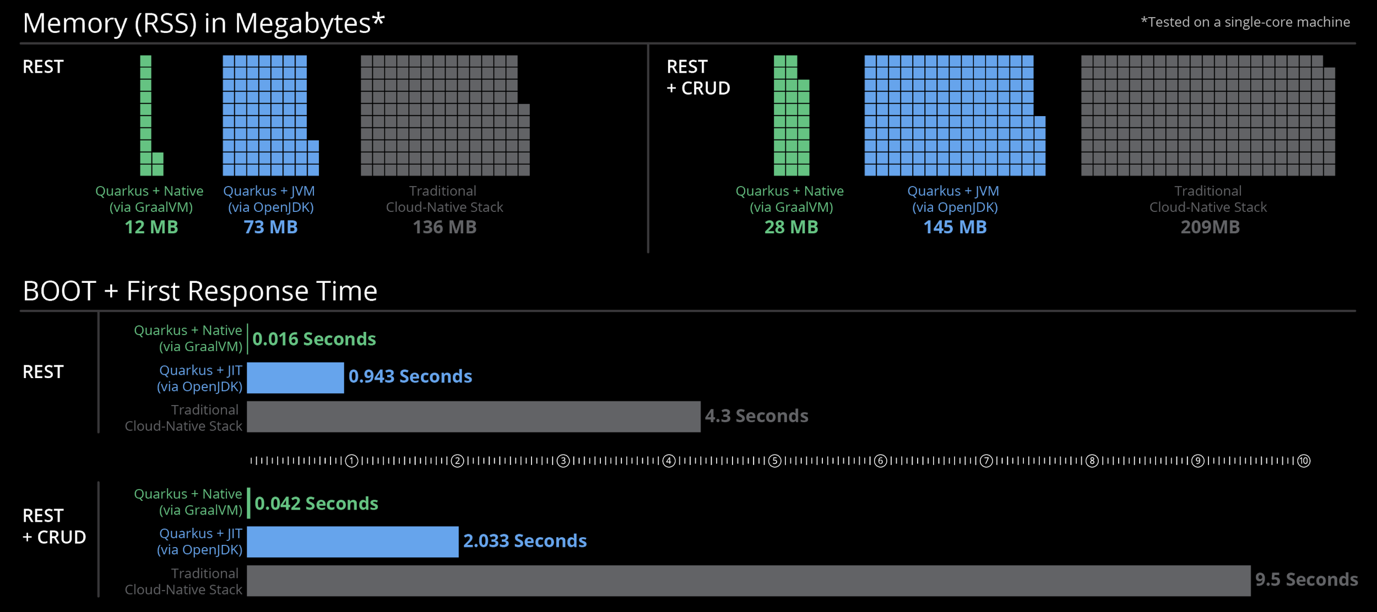
Introduction to Quarkus
Benefit No. 2: Supersonic Subatomic Java
*Memory (RSS) in Megabytes, tested on a single-core machine
Notes:
Linux
Single core + Java 8
Java 11 will be a bit higher, it’s getting comfortable and multiple cores affect the netty ergonomics and other frameworks

Slide 18
Introduction to Quarkus
Benefit No. 3: Unifies Imperative and Reactive
@Inject
SayService say;
@GET
@Produces(MediaType.TEXT_PLAIN)
public String hello() {
return say.hello();
}
@Inject @Channel(”kafka”)
Publisher<String> reactiveSay;
@GET
@Produces(MediaType.SERVER_SENT_EVENTS)
public Publisher<String> stream() {
return reactiveSay;
}
Combine both Reactive and imperative development in the same application
Use the technology that fits your use-case
Key for reactive systems based on event driven apps

Slide 19
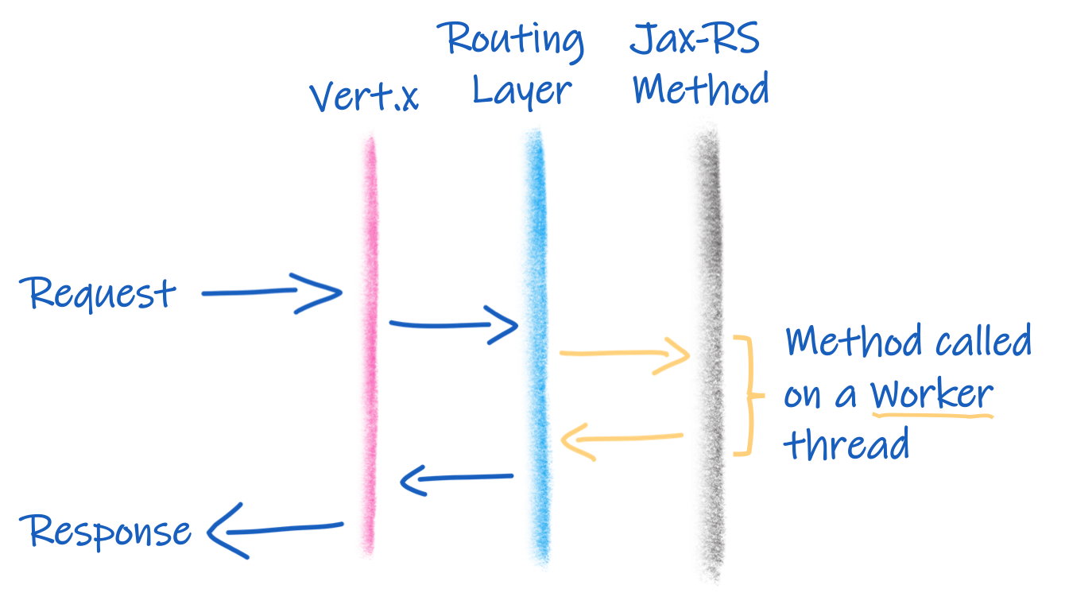
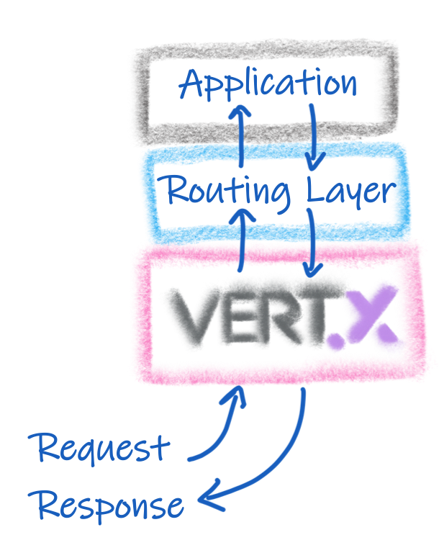
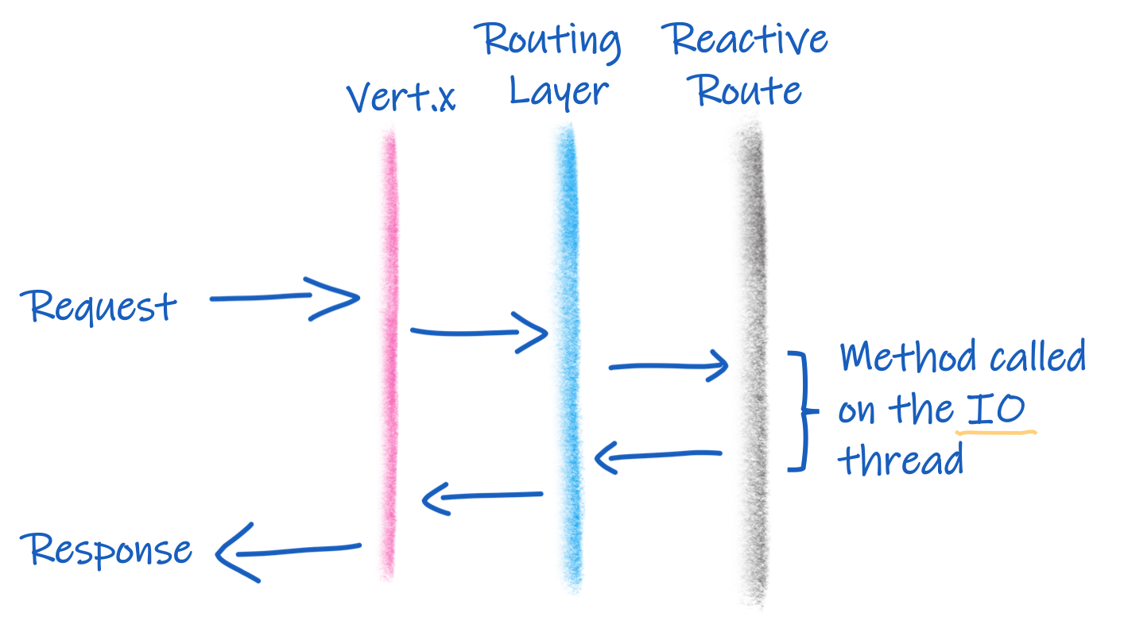
Quarkus is Reactive!

Slide 20
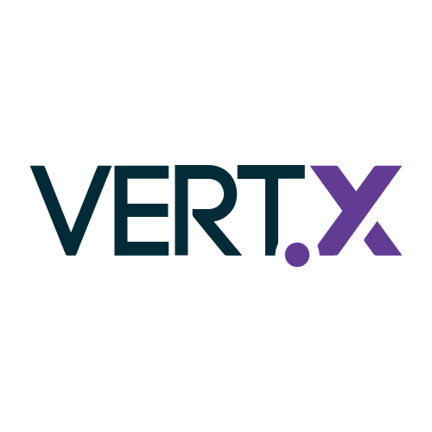

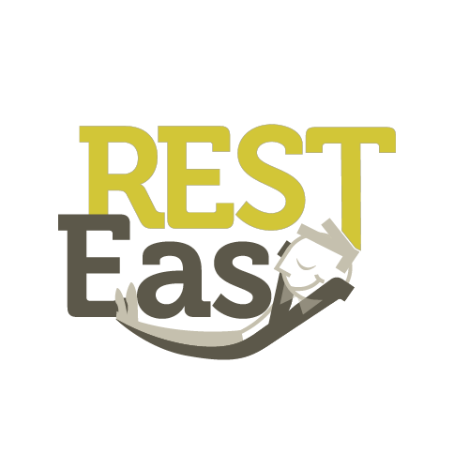



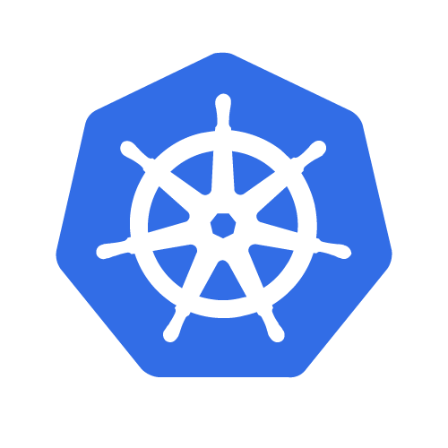





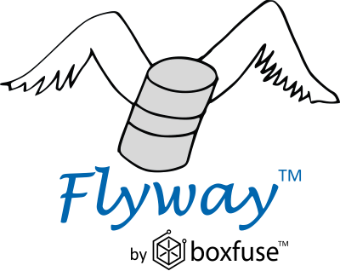




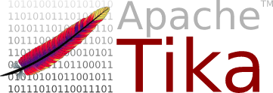
Benefit No. 4: Best of Breed Frameworks & Standards
“Reduced the time for developer productivity due to a small learning curve and existing expertise of the Quarkus extensions.”
Eclipse Vert.x
Hibernate
RESTEasy
Apache Camel
Eclipse MicroProfile
Netty
Kubernetes
OpenShift
Jaeger
Prometheus
Apache Kafka
Infinispan
Flyway
Neo4j
MongoDB
MQTT
KeyCloak
Apache Tika

Slide 21


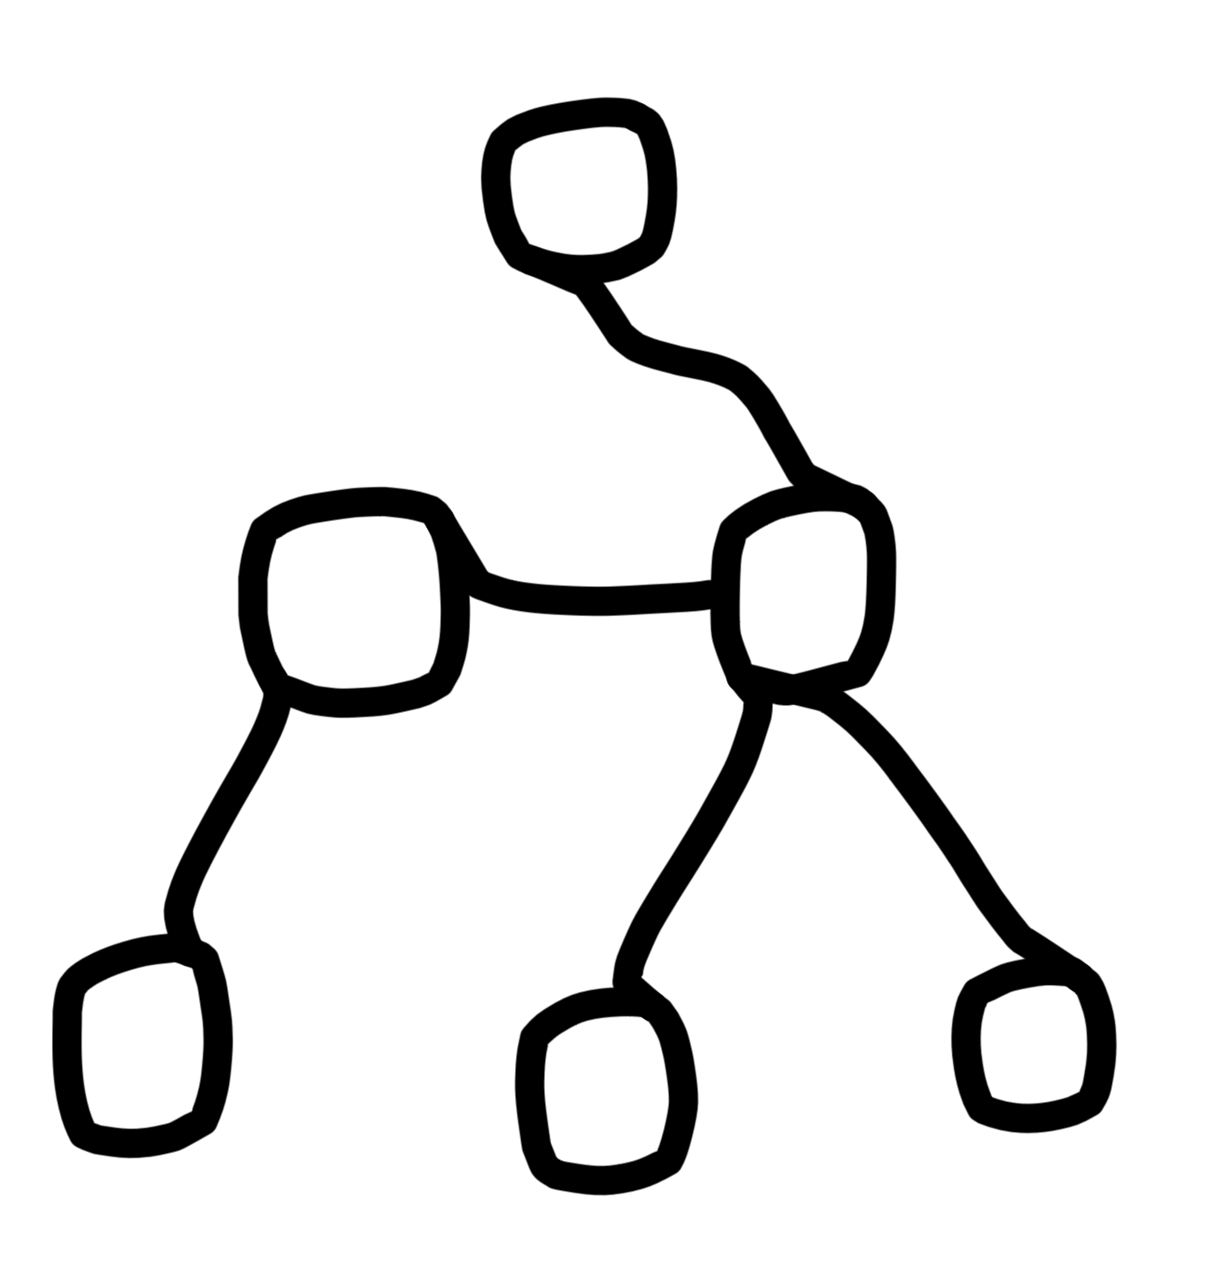
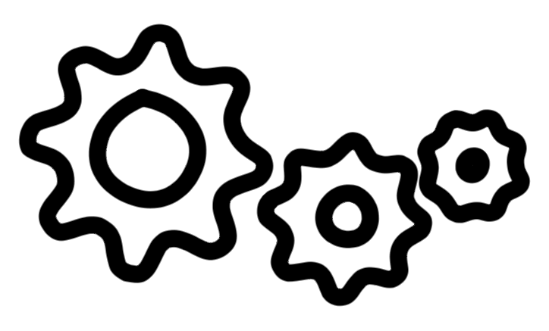
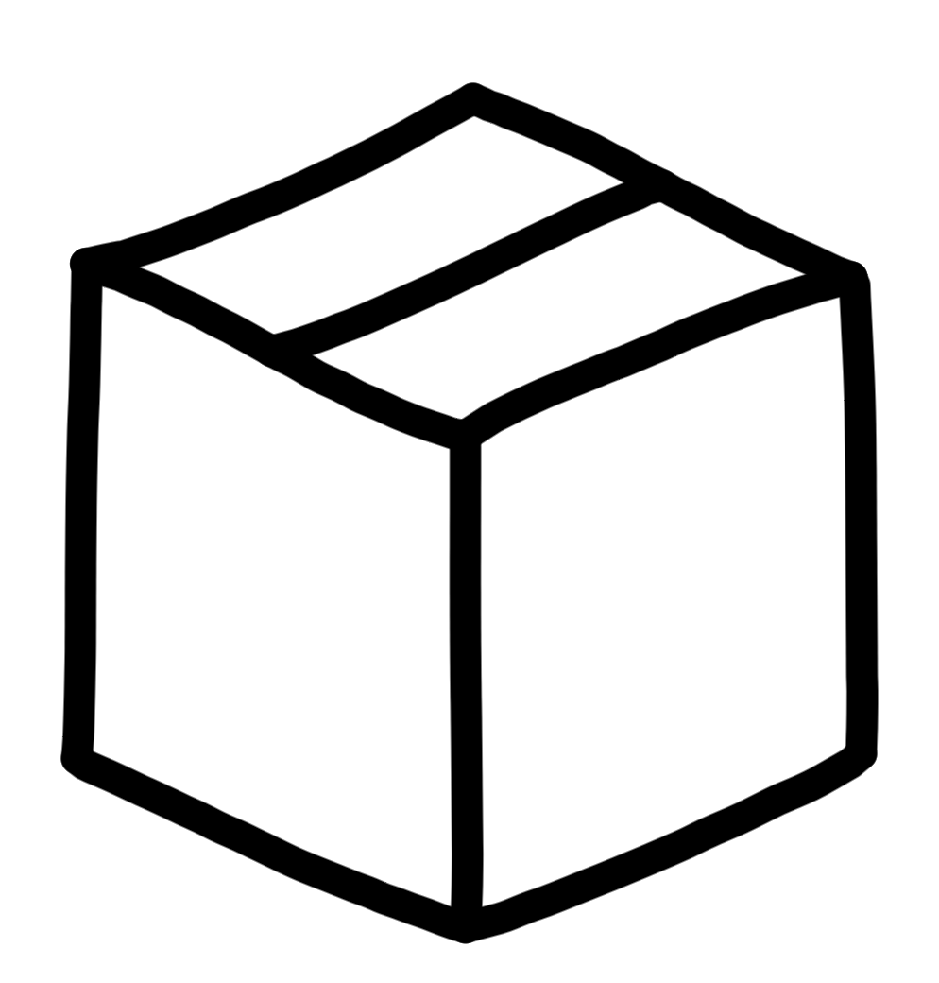




How Does a Framework Start?
Runtime
Build Time
@ @
</>
Packaging (maven, gradle…)
Load config file
from file system
Parse it
Classpath scanning to find
annotated classes
Attempt to load class to
enable/disable features
Build its model of the world.
Start the management (thread, pool…)

Slide 22
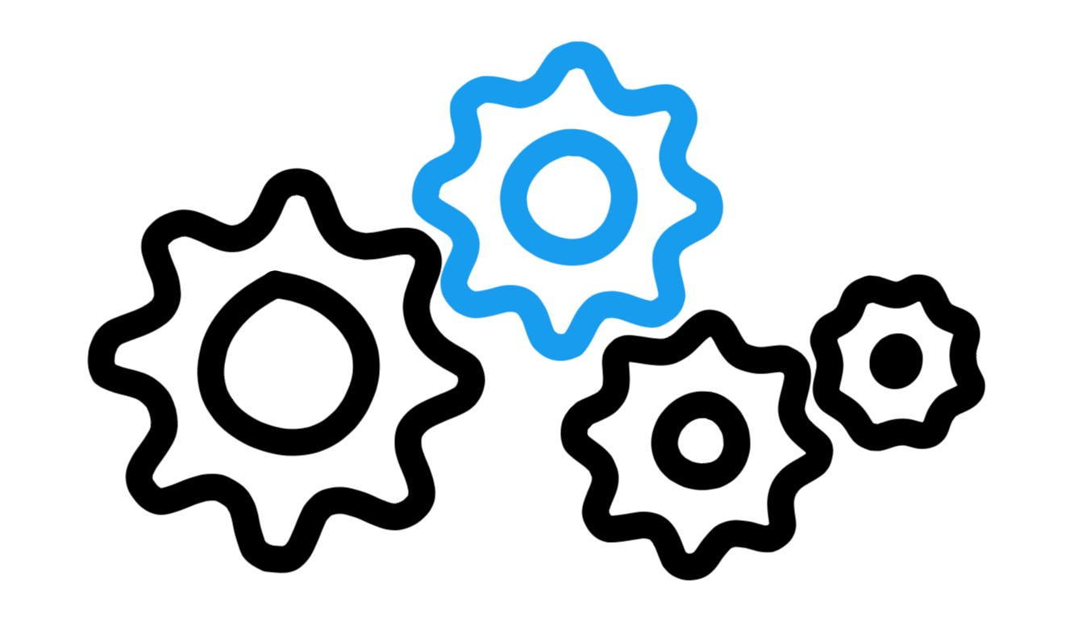
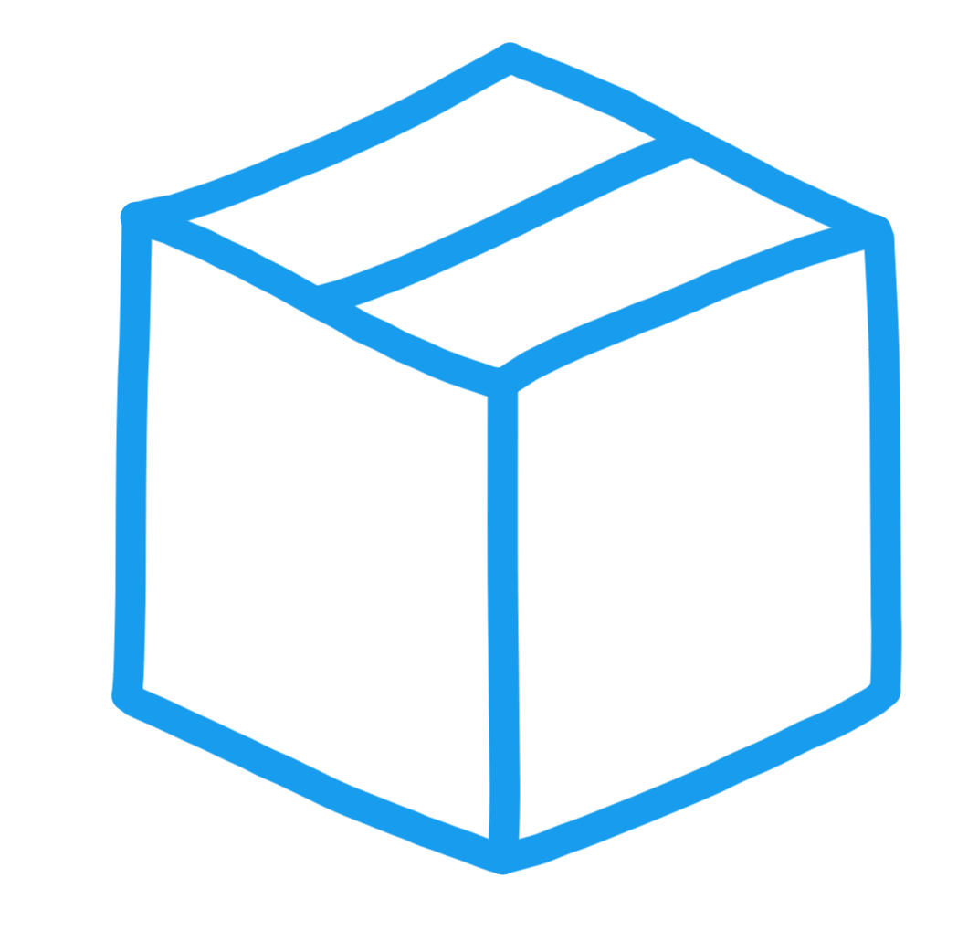
The Quarkus Way
Runtime
Build Time
@ @
</>
@ @
</>
Build Time
Runtime
Notes:
Framework Optimizations
Moved as much as possible to build phase
Minimized runtime dependencies
Maximize dead code elimination
Introduced clear metadata contracts
Spectrum of optimization levels (all → some → no runtime reflection)
Build Time Benefits
Do the work once, not at each start
All the bootstrap classes are no longer loaded
Less time to start, less memory used
Less or no reflection nor dynamic proxy
Optimizations benefit both GraalVM and HotSpot

Slide 23



Quarkus Build Process
Compile
Provision
(curate)
Wiring & Assemble
(augment)
Hotspot Runnable & Image
AOT Native Compilation
Native Executable & Image
app.jar
frameworks
Runnable java app
native-app

Slide 24
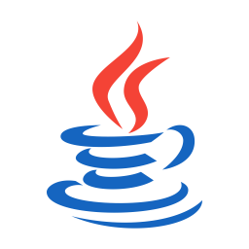

“MODERN” JAVA APP STACK
MONOLITHS, MICROSERVICES
SINGLE APP
DAYS OF LIFE
100s MB RAM
SECONDS TO START
QUARKUS
MICROSERVICES, SERVERLESS
SINGLE APP
SECONDS TO DAYS OF LIFE
10s MB RAM
MILLISECONDS TO START
App
Dynamic Application Frameworks
App
Application Server
Optimized Application Frameworks
Java Virtual Machine (Hotspot)
Java Virtual Machine (Hotspot)
Optional

Slide 25
Kubernetes Native
Quarkus Fundamentals
Quarkus Top-10 Kubernetes Features
One-step Kubernetes deployment
Remote live-coding in Kubernetes
Direct ConfigMap and Secrets access
Health endpoints
Kubernetes Client API
OpenMetrics support
OpenTracing support
One-step KNative deployment
Functions-as-a-Service with Funqy
Fast startup and low-memory usage

Slide 26
Let’s Demo

Slide 27
An Open Source
stack to write Java apps
Cloud Native
Microservices
Serverless
Demo with mvn quarkus:dev, jar, native, https://github.com/quarkusio/quarkus-quickstarts.git
Notes:
Quarkus is an open source stack to write Java apps.
It targets not the monoliths of the past,
But instead targets what developers are doing today: writing cloud native microservices and designing serverless apps that are deployed to cloud infrastructure like Kubernetes and OpenShift and take advantage of the underyling platform to do amazing things.

Slide 28
Migrate Old Applications New Again

Slide 29

OPTIONS FOR CONTAINERIZATION
RETAIN
Keep and don’t touch for now.
Low
RETIRE
Decommission end-of-life application.
REHOST (Lift & Shift)
Repackage and move existing applications with as few changes as possible.
REPLATFORM (Lift & Reshape)
Change the underlying platform (runtime, framework, middleware, operating system).
Transformation Efforts / Complexity
Existing Application
REFACTOR (Extend / Rewrite)
Redesign code to take advantage of the new platform (extend, strangle, rewrite).
REPURCHASE (Drop & Shop)
Replace by Commercial off-the-shelf (COTS) or Software-as-as-Service (SaaS).
High

Slide 30
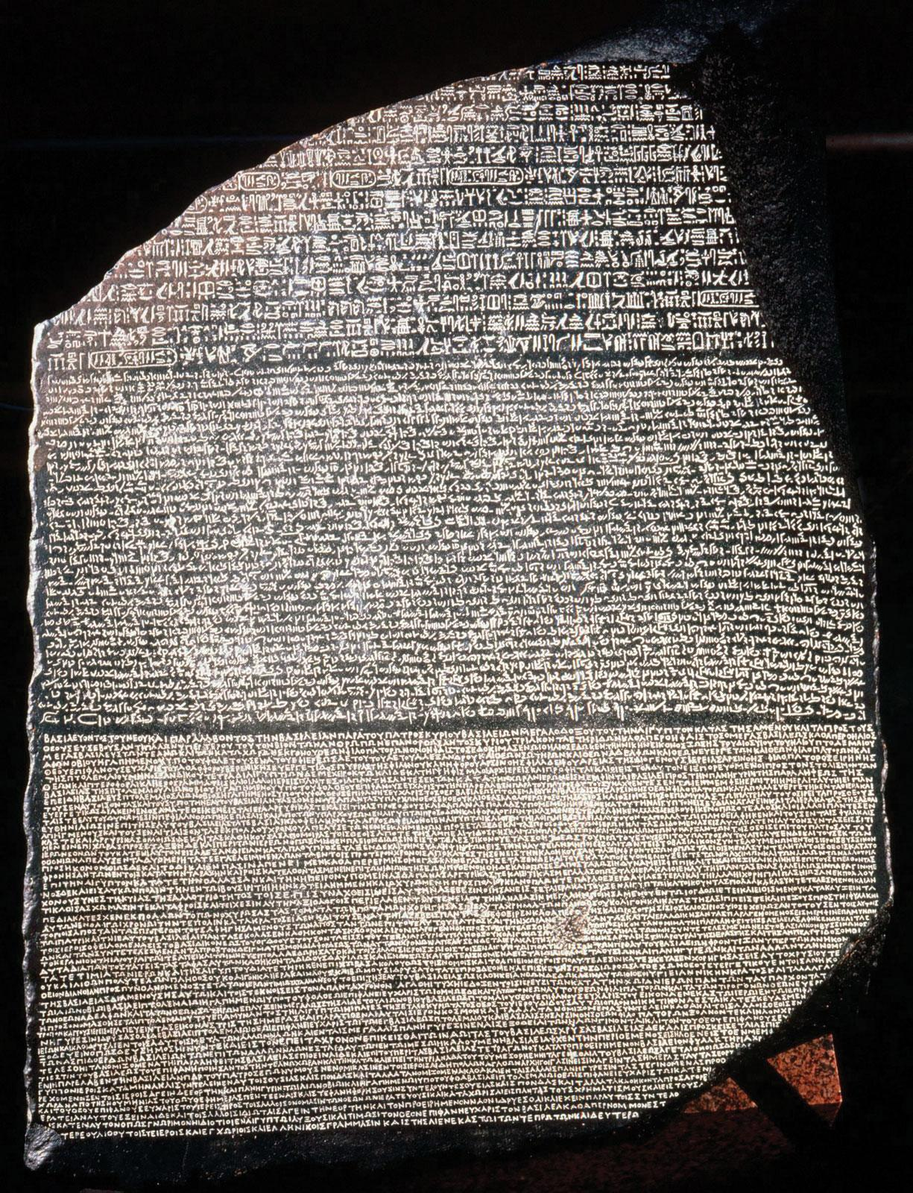

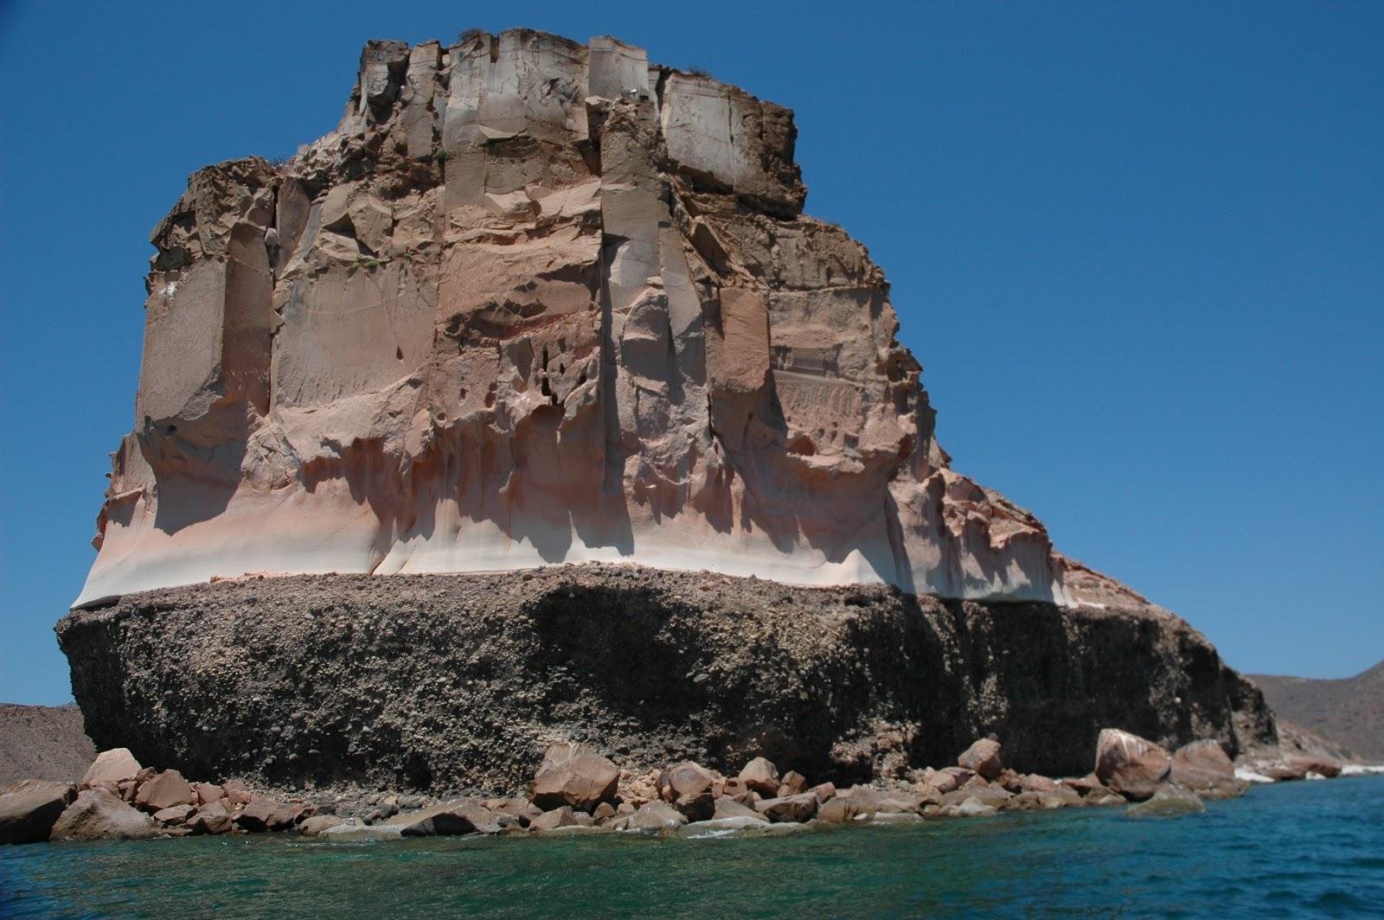

How to accelerate Application Migrations
Where tooling can make the migration easier
Goal: Lower the barrier of entry into Kubernetes from other Platforms
Convert deployment artifacts from other platforms
Scan code for common migration pitfalls
Fallback option to simulate legacy platforms
Plug into existing pipelines
Speed and accuracy are paramount

Slide 31
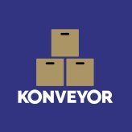
Migration Tooling
Migrate applications between Kubernetes clusters
KONVEYOR.IO
Crane
Forklift
Migrate virtual machines to Kubernetes (KubeVirt)
rehost
Existing Applications & Infrastructure
Migrate containers from alternative container orchestration to Kubernetes
replatform
Move2Kube
refactor
Pathfinder
Assess Applications for Container Suitability
retain
repurchase
Analyze Java Applications for modernization
retire
Windup/RHMTA
Measure the impact of changes on software delivery performance
Pelorus

Slide 32

REFACTOR MONOLITH TO CLOUD
HTML
Javascript
Web
HTML
Javascript
Web
Service
Service
Service
Service
Service
Service
Service
Service
Service
Service
Service
Service
Data Access
Data Access
Application Server

Slide 33


HOW TO LIFT-AND-SHIFT MONOLITH TO CLOUD
GENERAL AMM APPROACH
Step-by-step approach with well-defined scope & activities.
Image choice, initial configuration
Pre-emptive code changes (e.g. RHAMT)
Get application running in a container
Optional changes (refactor, strangle)
Test & Promote
Notes:
Risk-averse strategy:
→ As few changes as possible. As many as necessary. Nothing more, nothing less.
All activities are bounded and well defined in advance based on the outcome of the assessment.
1. Image choice
Choosing a container image or a template which may have been defined
2. Pre-emptive changes → e.g. findings and their solutions from the migration toolkit, use defined building blocks with have been identified as solution during the assessment / when other apps have been transformed.
3. Get application running in a container → Kind of trial and error until the app is running with those minimal changes. Think of it like a Fast moving monolith at this point.
4. Optional changes → any kind of additional activities (cloud-readiness, clean-code, refactoring, usage of cloud-native/kubernetes/container patterns) we agreed to do.
5. Basically about pipelines which Marc will elaborate in more detail.
⇒ Discuss for each step if it is manual or automated.

Slide 34
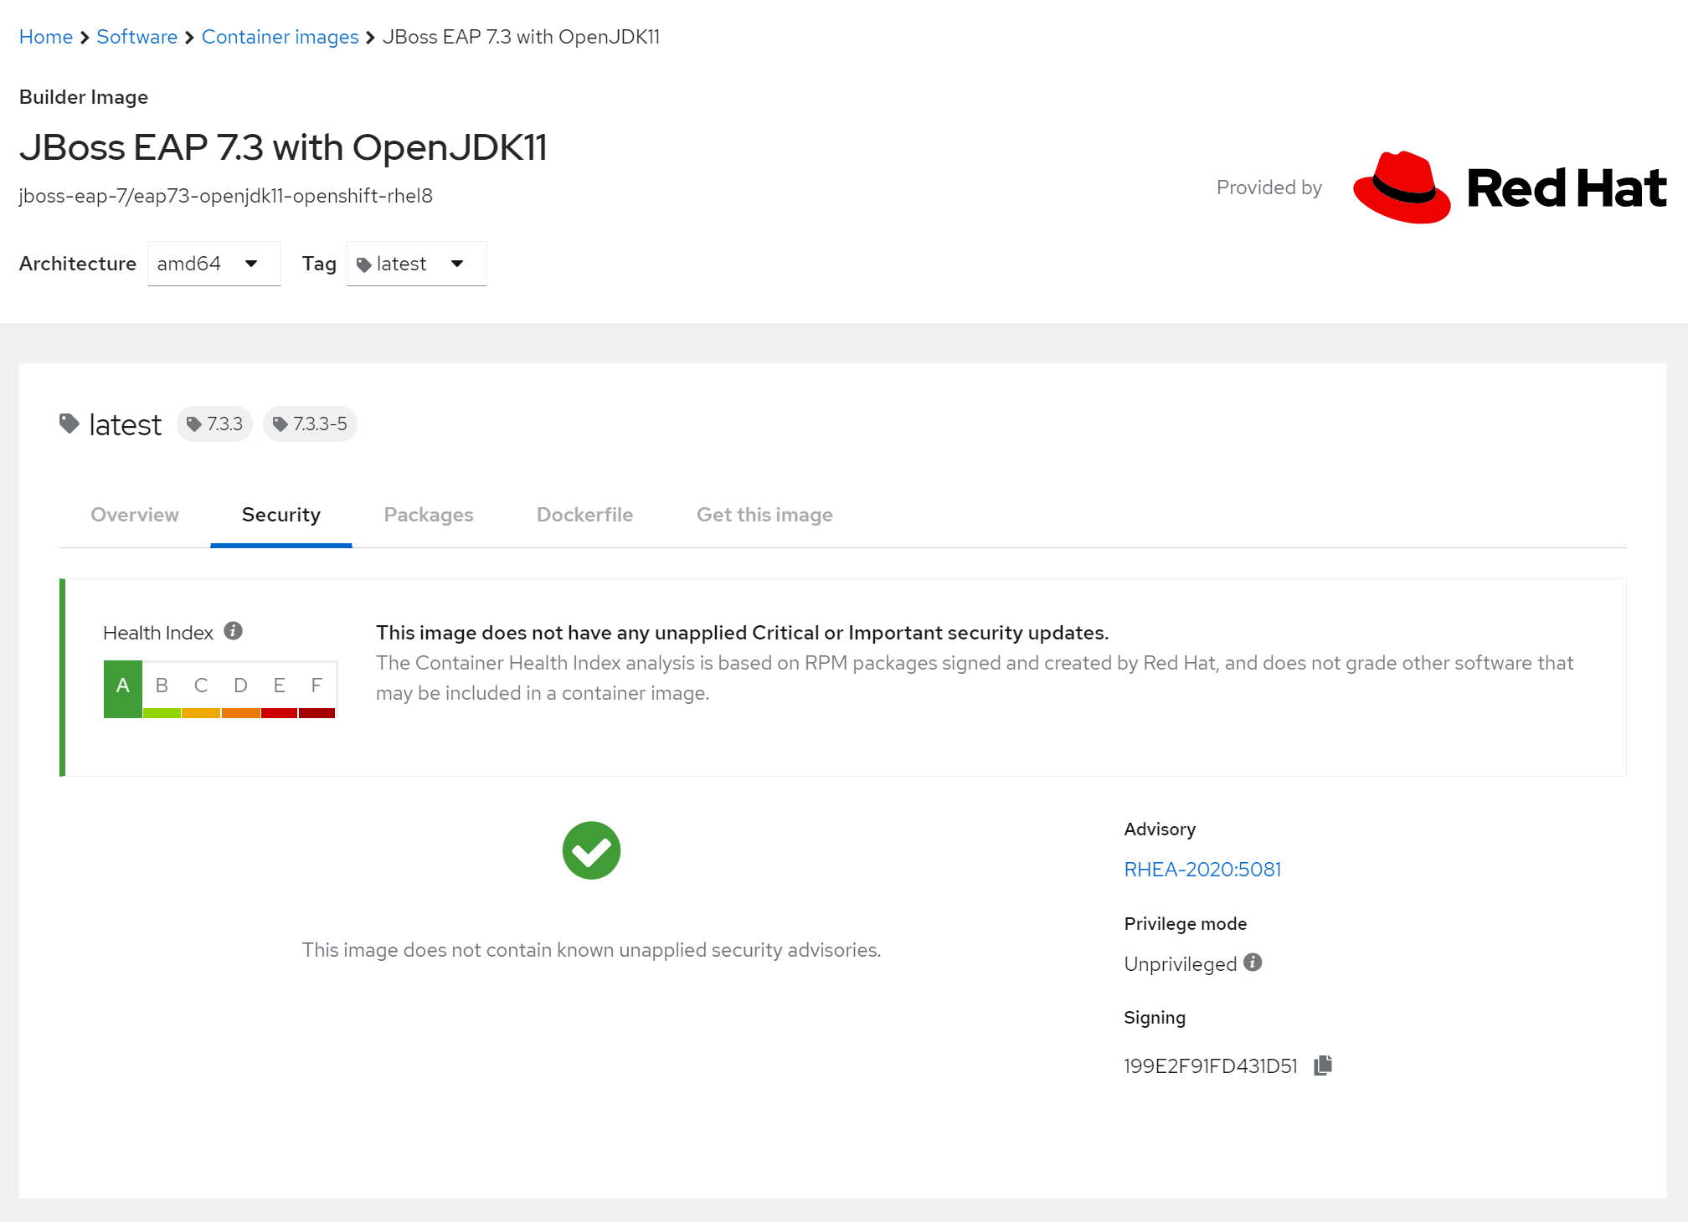
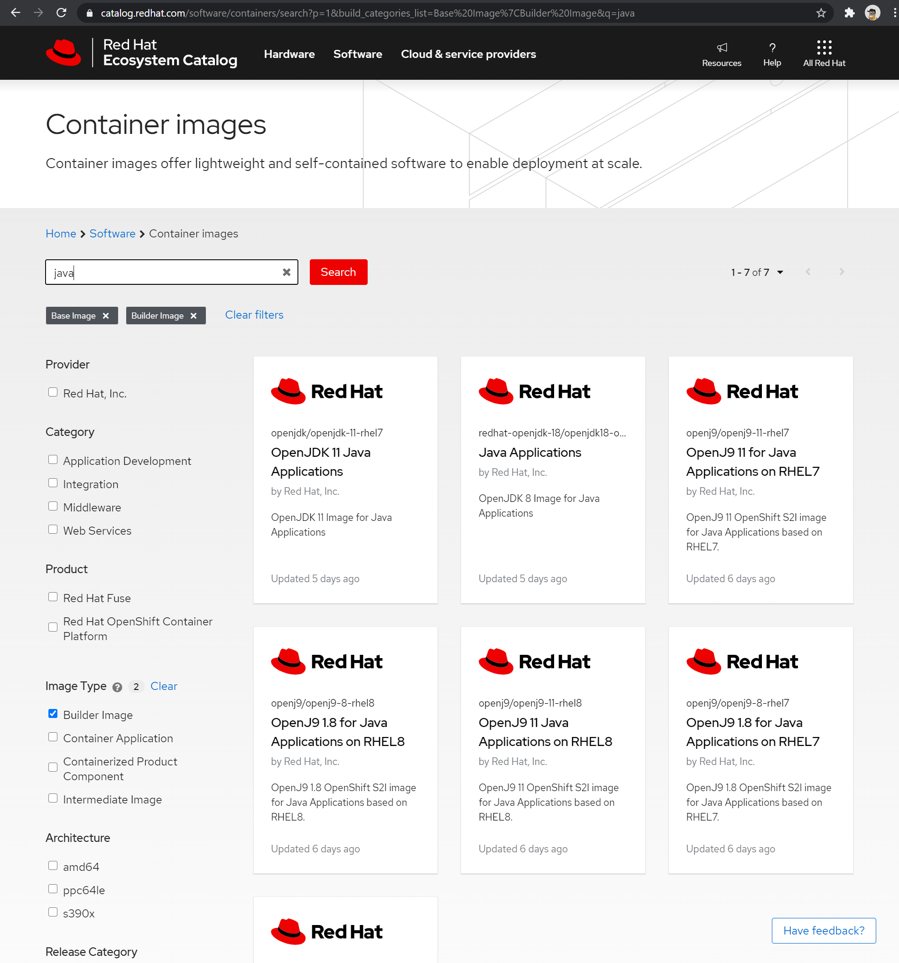
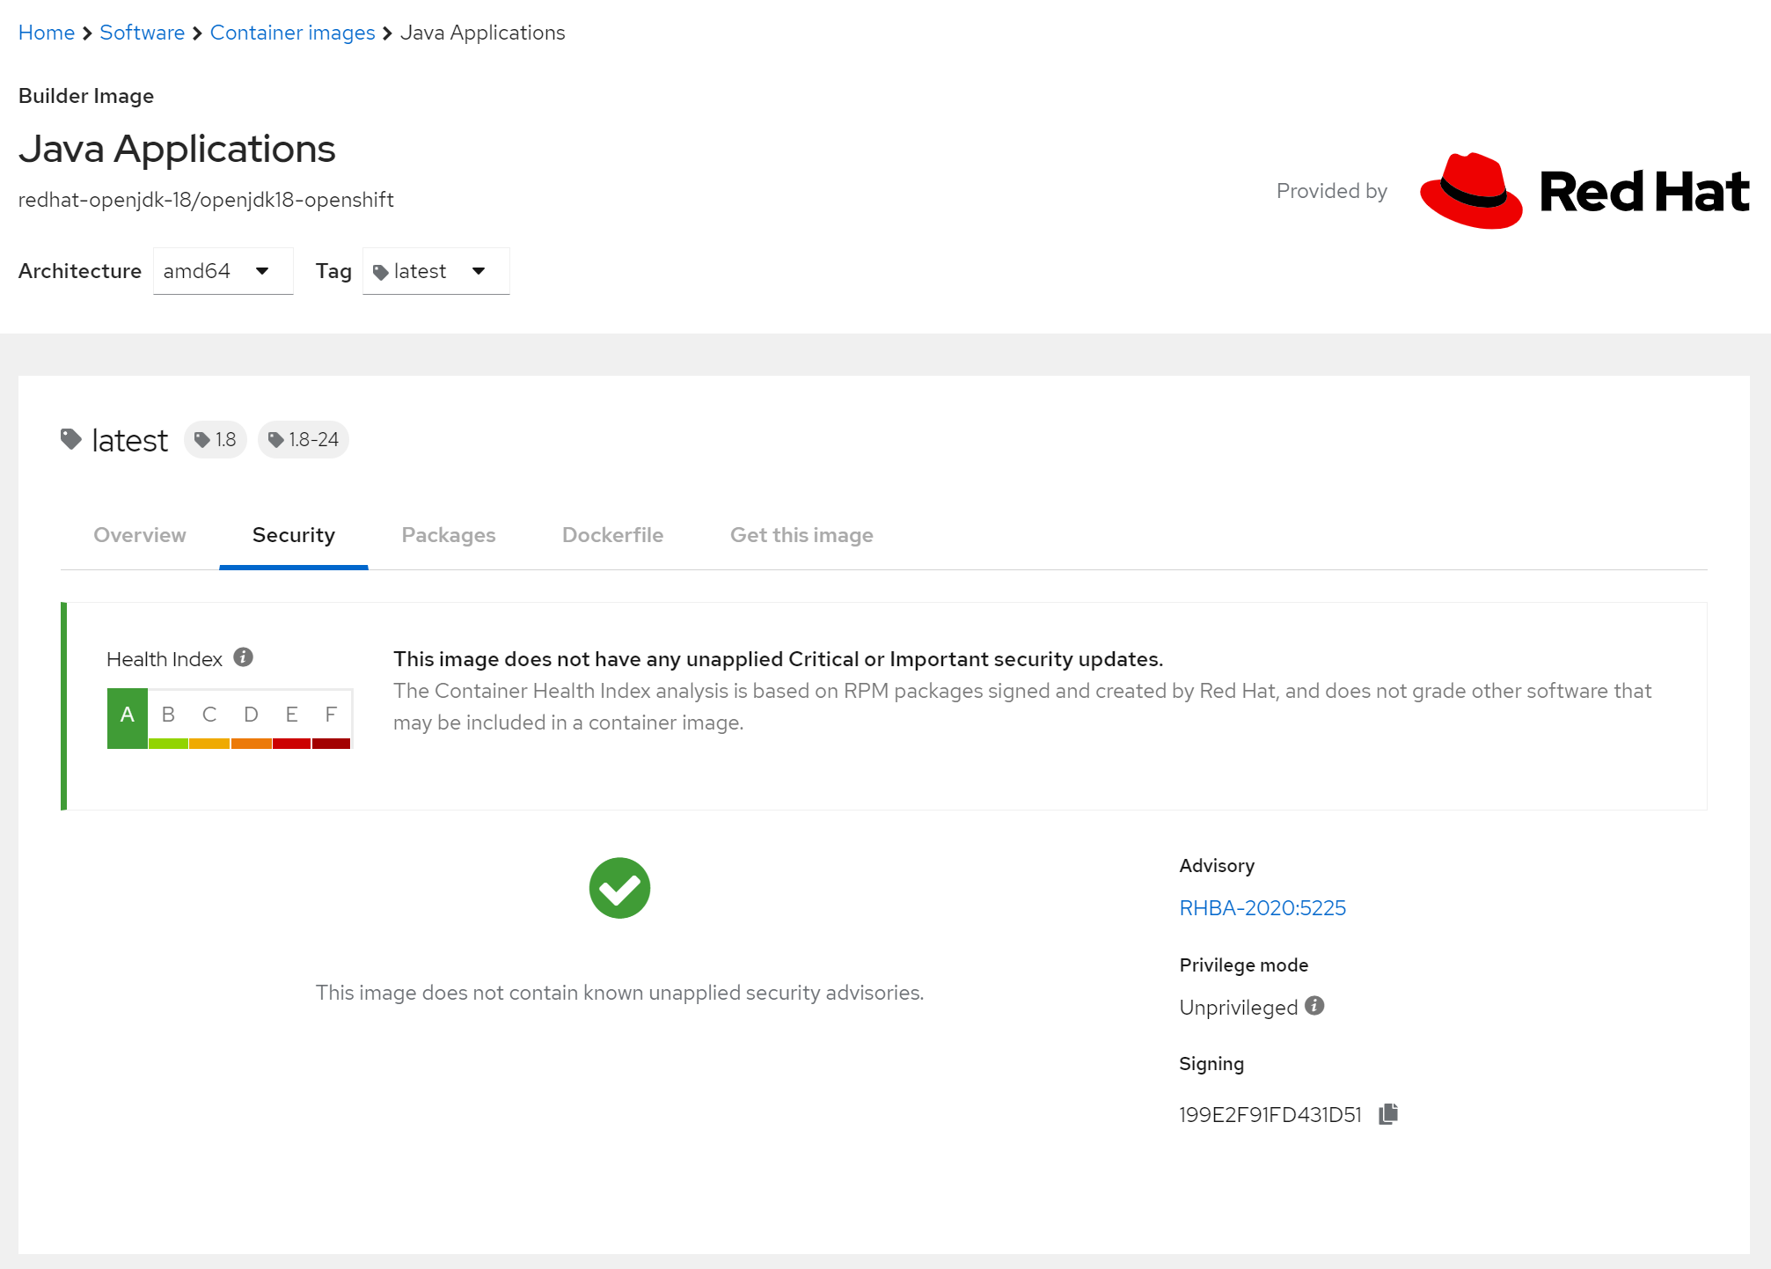
Image Choice

Slide 35
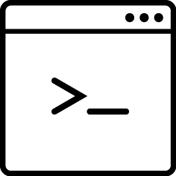

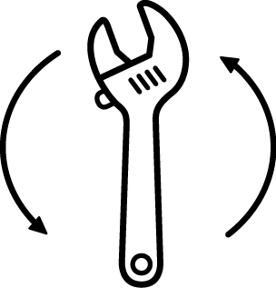


Red Hat Application Migration Toolkit Overview
TOOL: RED HAT A.M.T.
Catalyze large scale application modernizations and migrations
Automate analysis
Support effort estimation
Accelerate code migration
Bring workloads to OpenShift
Free & open source
Leveraged by Red Hat Consulting
IBM WebSphere AS
Oracle
WebLogic Server
Java EE & JDK upgrades
JBoss EAP upgrades
Cloud readiness,
containerization
Pluggable: your own rules
Command line interface
Web console
Eclipse plugin
Maven plugin
Notes:
So, so much for the theory. Now we want to show you a tool we have which helps us in the process of automating the assessment
Called: application migration toolkit
RHAMT
Set of tools… to catalyze large-scale application modernizations & migrations.
Helps tremendously in finding details whic would take much longer if done manually
Analysis of patterns present in JAVA applications, this done by using rules.
Pluggable: you can customize the existing rules or create own rules that fit your customer needs
Generates top-down web reports showing a lot of insights on the application.
TRANSFO PATHS
-> initially Java EE migrations, quite some rulesets covering AS migrations
-> steadily growing rulesets for container readiness
-> toolkit -> consists of multiple tools.
-> efforts / technologies used / container-readiness

Slide 36
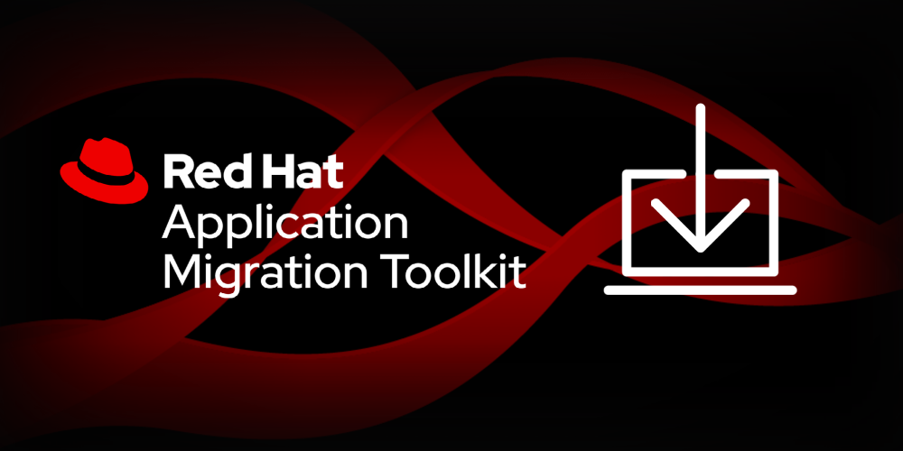
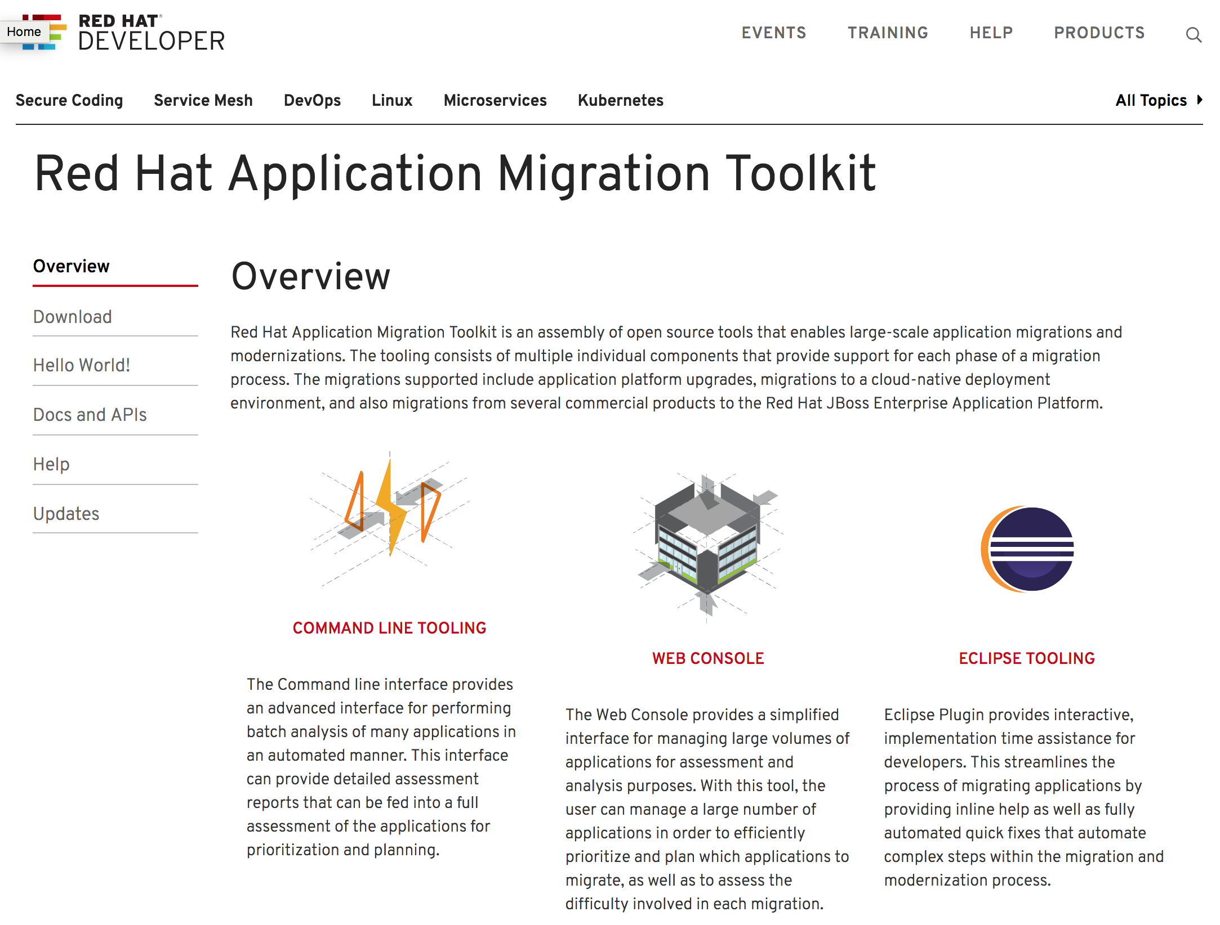
Project Page
TOOL: RED HAT A.M.T.
Download the Toolkit on https://developers.redhat.com/products/rhamt/overview/
Source:
https://developers.redhat.com/products/rhamt/overview

Slide 37
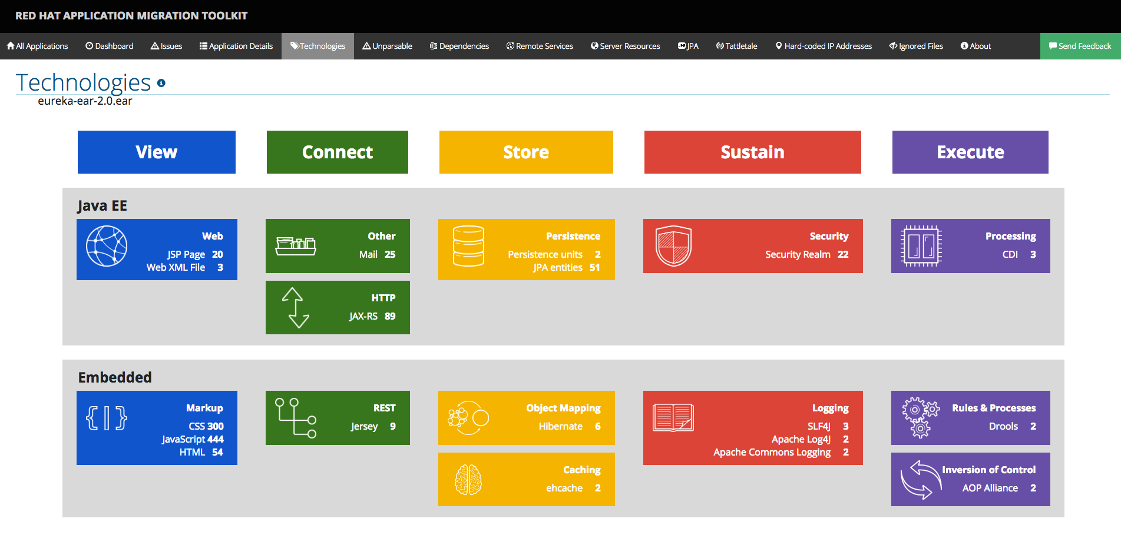
TOOL: RED HAT A.M.T.
Source:
https://developers.redhat.com/products/rhamt/overview

Slide 38
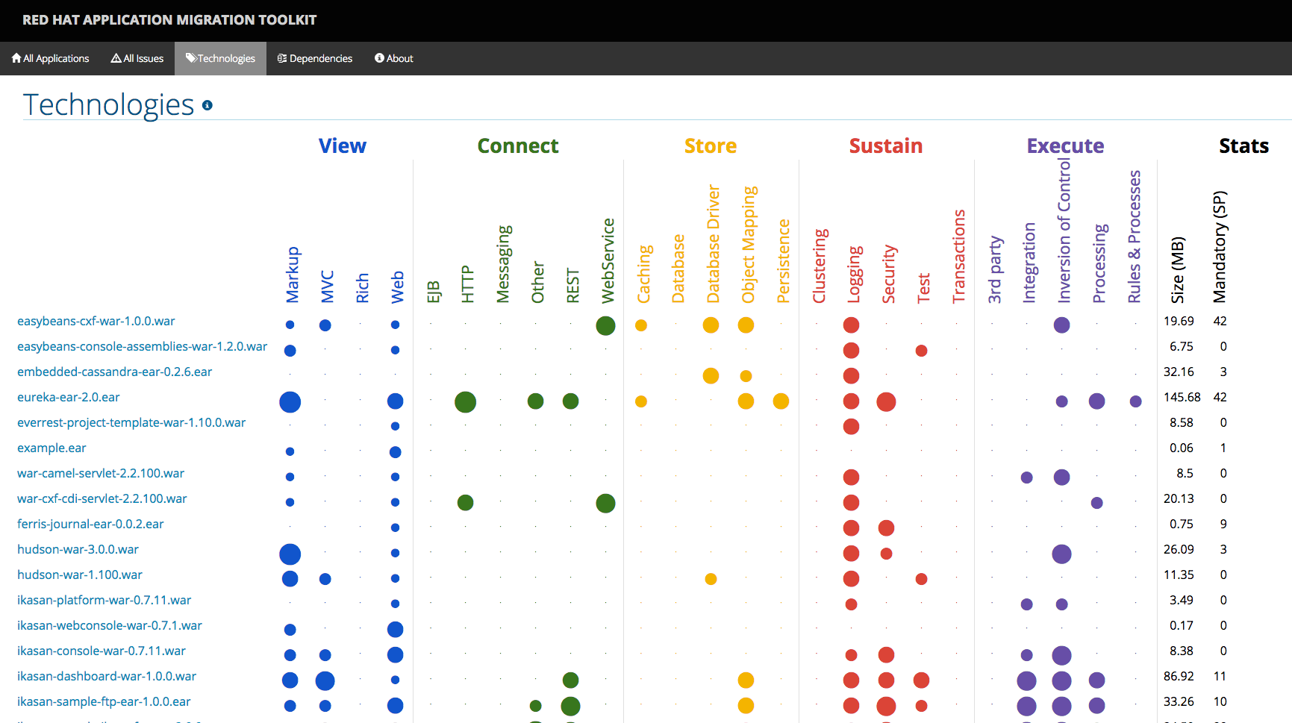
TOOL: RED HAT A.M.T.
Source:
https://developers.redhat.com/products/rhamt/overview

Slide 39
Red Hat Application Migration Toolkit Results & prioritization
TOOL: RED HAT A.M.T.
App B
App A
Effort estimated by the tool, business value by customer
Enables to produce a migration path
Technical risks identified
To select the technical PoC to perform
Changes identified
Allowing to plan migration
Container-ready
App C
Container Readiness
Containerization status
Done!
In progress
App F
App D
Not started
Out-of-scope!
App E
Container-alien
Level-of-Effort
Low
Business value
High
Source:
https://developers.redhat.com/products/rhamt/overview
Notes:
Example of expected results at the end of the assessment.
Level of efforts is dependant on the chosen pattern.

Slide 40

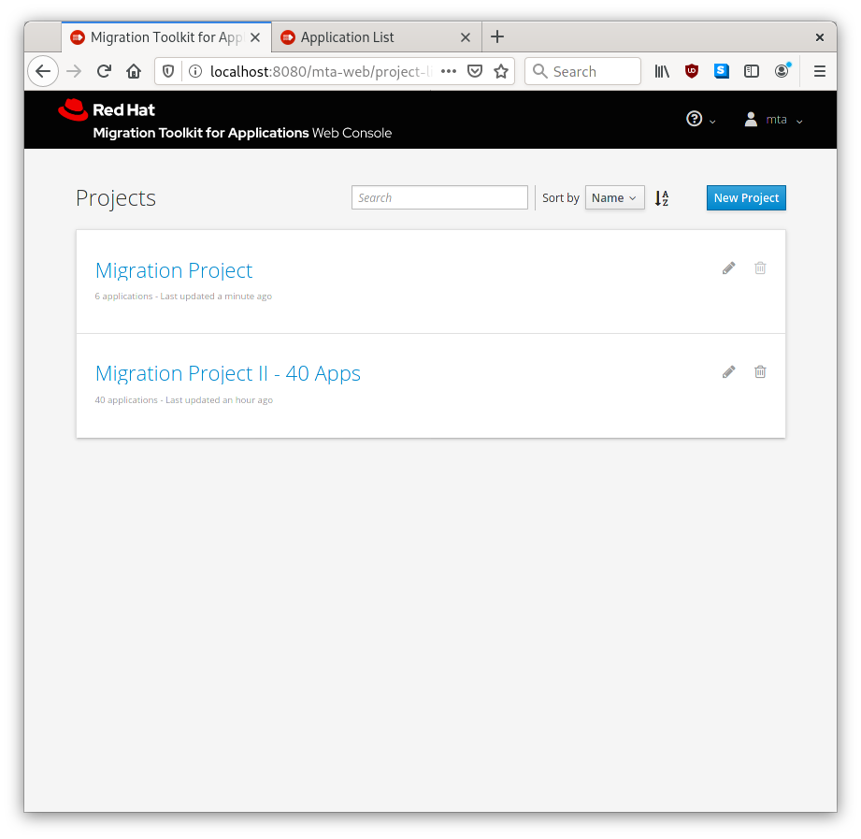
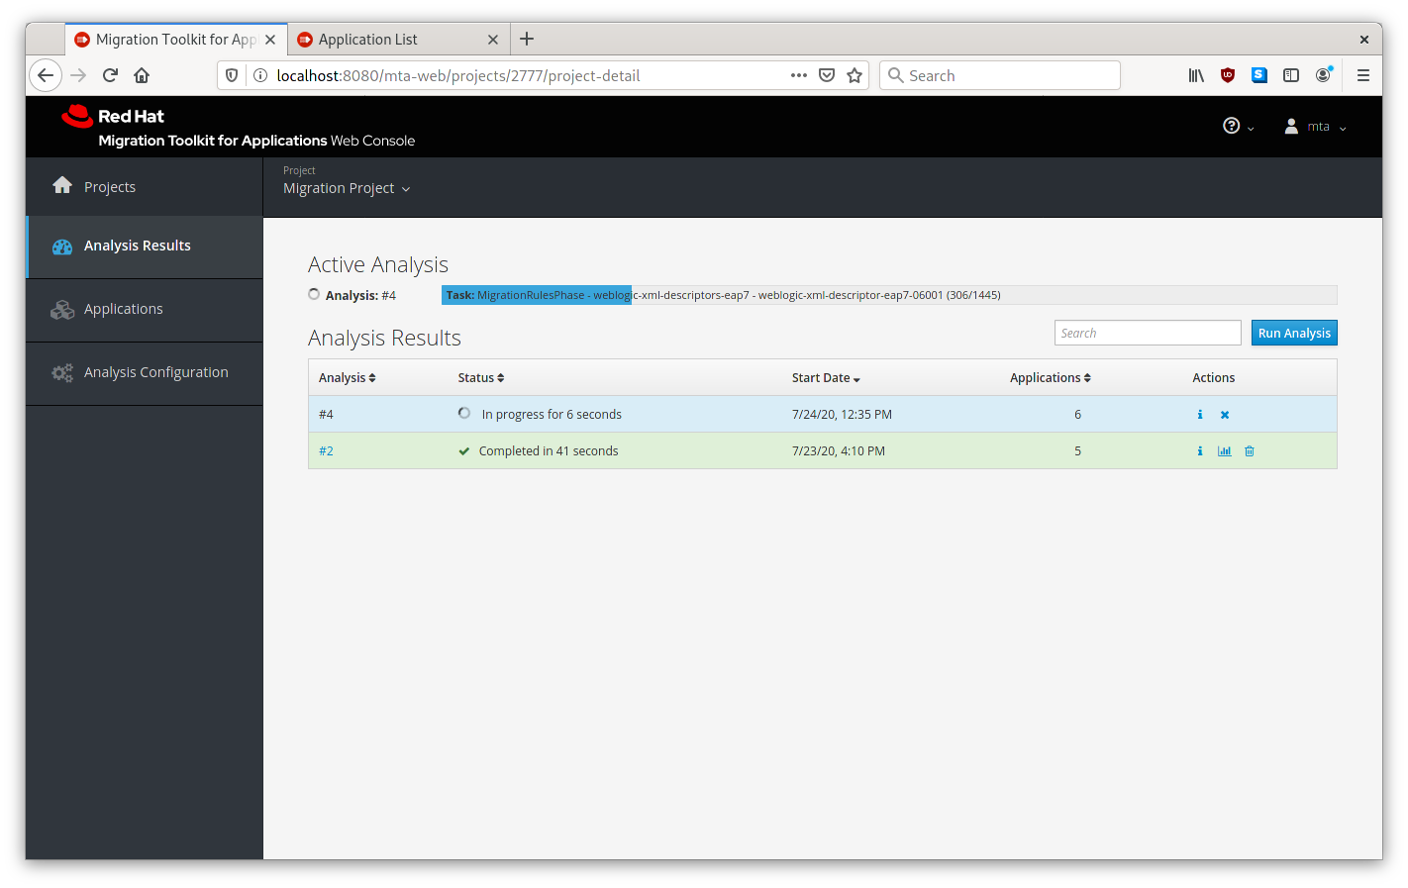
Migration Toolkit for Applications
APPLICATION MODERNIZATION AND MIGRATION TOOLING
Web Console: manage projects and applications

Slide 41
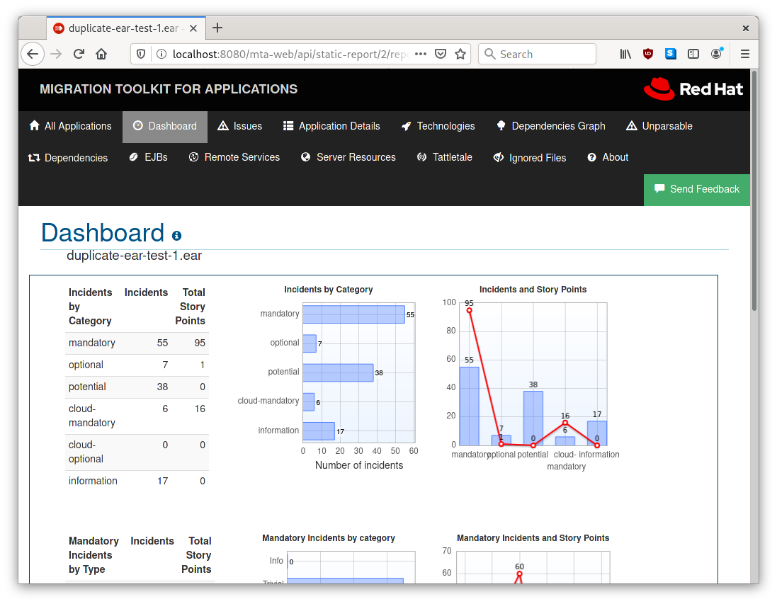
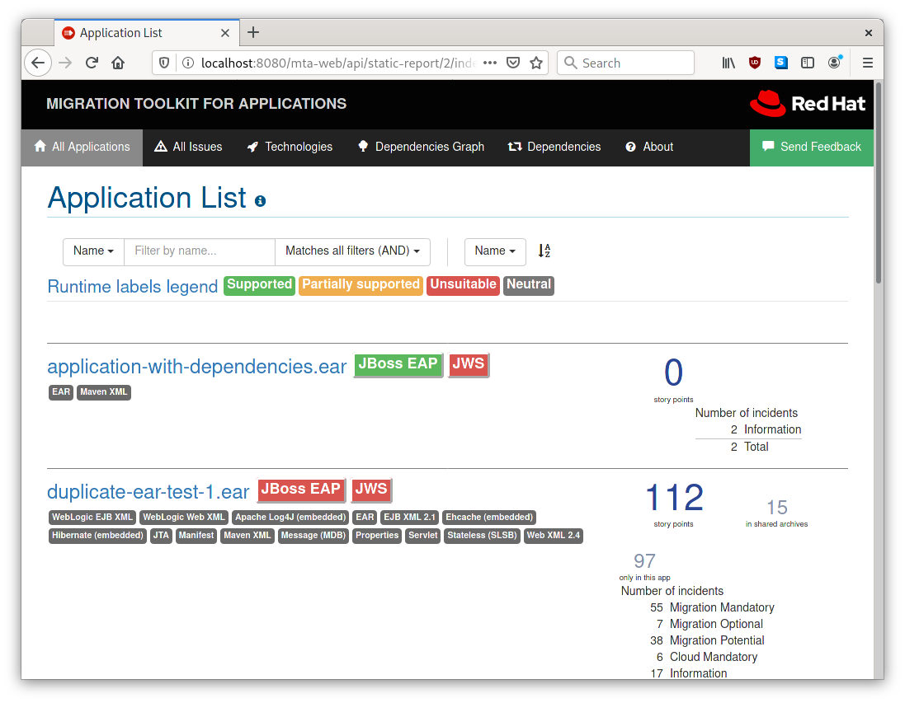
Migration Toolkit for Applications
APPLICATION MODERNIZATION AND MIGRATION TOOLING
Web Console: issue type analysis and support for effort estimation

Slide 42
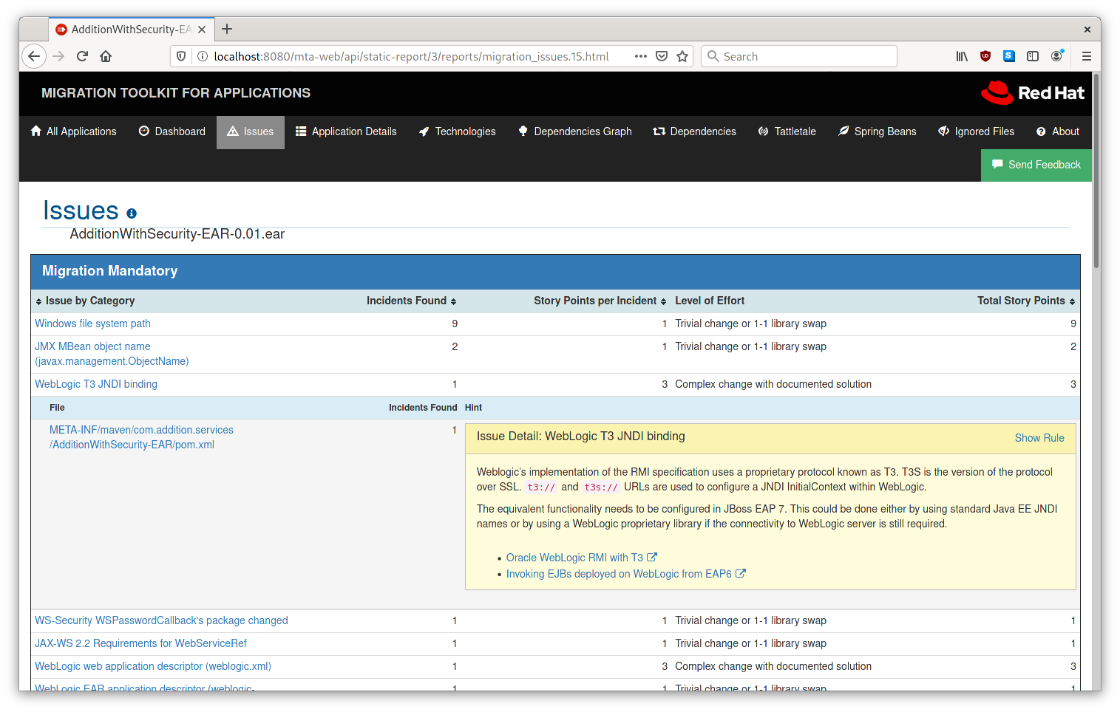
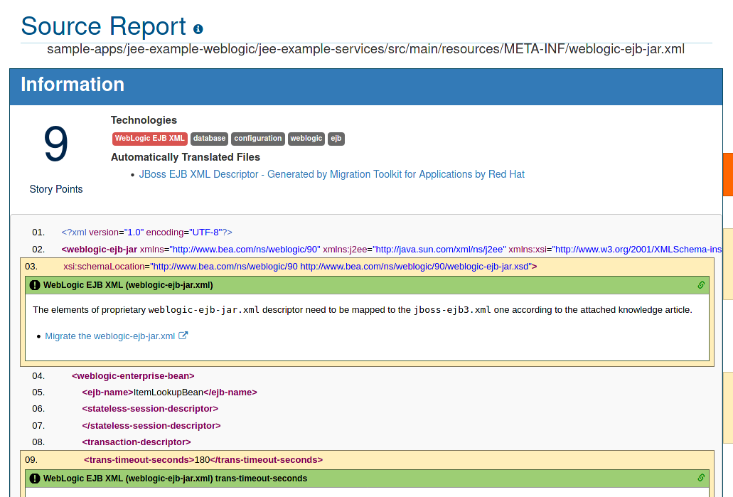
Migration Toolkit for Applications
APPLICATION MODERNIZATION AND MIGRATION TOOLING
Web Console: examine hints and introspect application source code

Slide 43
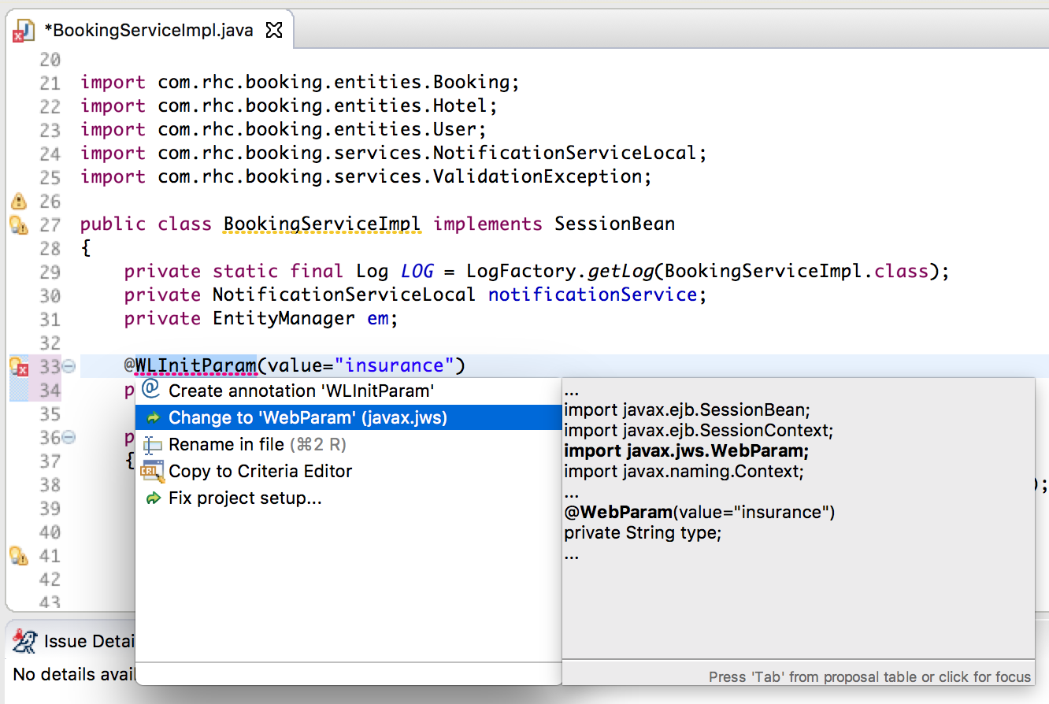
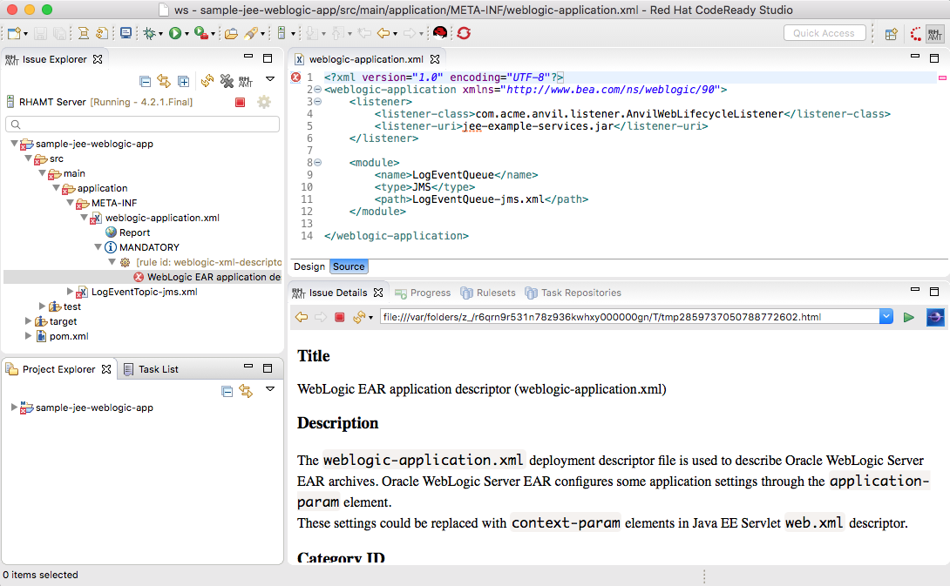
Migration Toolkit for Applications
APPLICATION MODERNIZATION AND MIGRATION TOOLING
IDE Plugins: task list, inline hints, support for code changes
Eclipse / Code Ready Studio / VS Code / Eclipse CHE
Notes:
TODO: Add VSCode extensions screenshots

Slide 44
Use Cases
APPLICATION MODERNIZATION AND MIGRATION TOOLING
Source Platform | Targets
 | Migration to JBoss EAP 6 | Migration to JBoss EAP 7 | OpenShift (cloud readiness) | OpenJDK 8 & 11 | Camel 3 | Spring Boot in RH Runtimes
Oracle® WebLogic Server | ✔ | ✔ | ✔ | ✔ | - | -
IBM® WebSphere® Application Server | ✔ | ✔ | ✔ | ✔ | - | -
JBoss EAP 4 | ✔ | ✘ [1] | ✔ | ✔ | - | -
JBoss EAP 5 | ✔ | ✔ | ✔ | ✔ | - | -
JBoss EAP 6 | N/A | ✔ | ✔ | ✔ | - | -
JBoss EAP 7 | N/A | ✔ | ✔ | ✔ | - | -
Oracle JDK | - | - | ✔ | ✔ | - | -
Camel 2 | - | - | ✔ | ✔ | ✔ | -
Spring Boot | - | - | ✔ | ✔ | - | ✔
Any Java application | - | - | ✔ | ✔ | - | -
https://developers.redhat.com/products/mta/use-cases
Notes:
Catalyze large scale application modernizations and migrations
Accelerate analysis
Technologies used
Proprietary libraries/APIs
Technical debt
Support effort estimation
Relative effort - story points
Take duplications into account
Accelerate code migration
Code change guidance
Solve problems only once
Create organizational standards

Slide 45
Let’s Demo

Slide 46
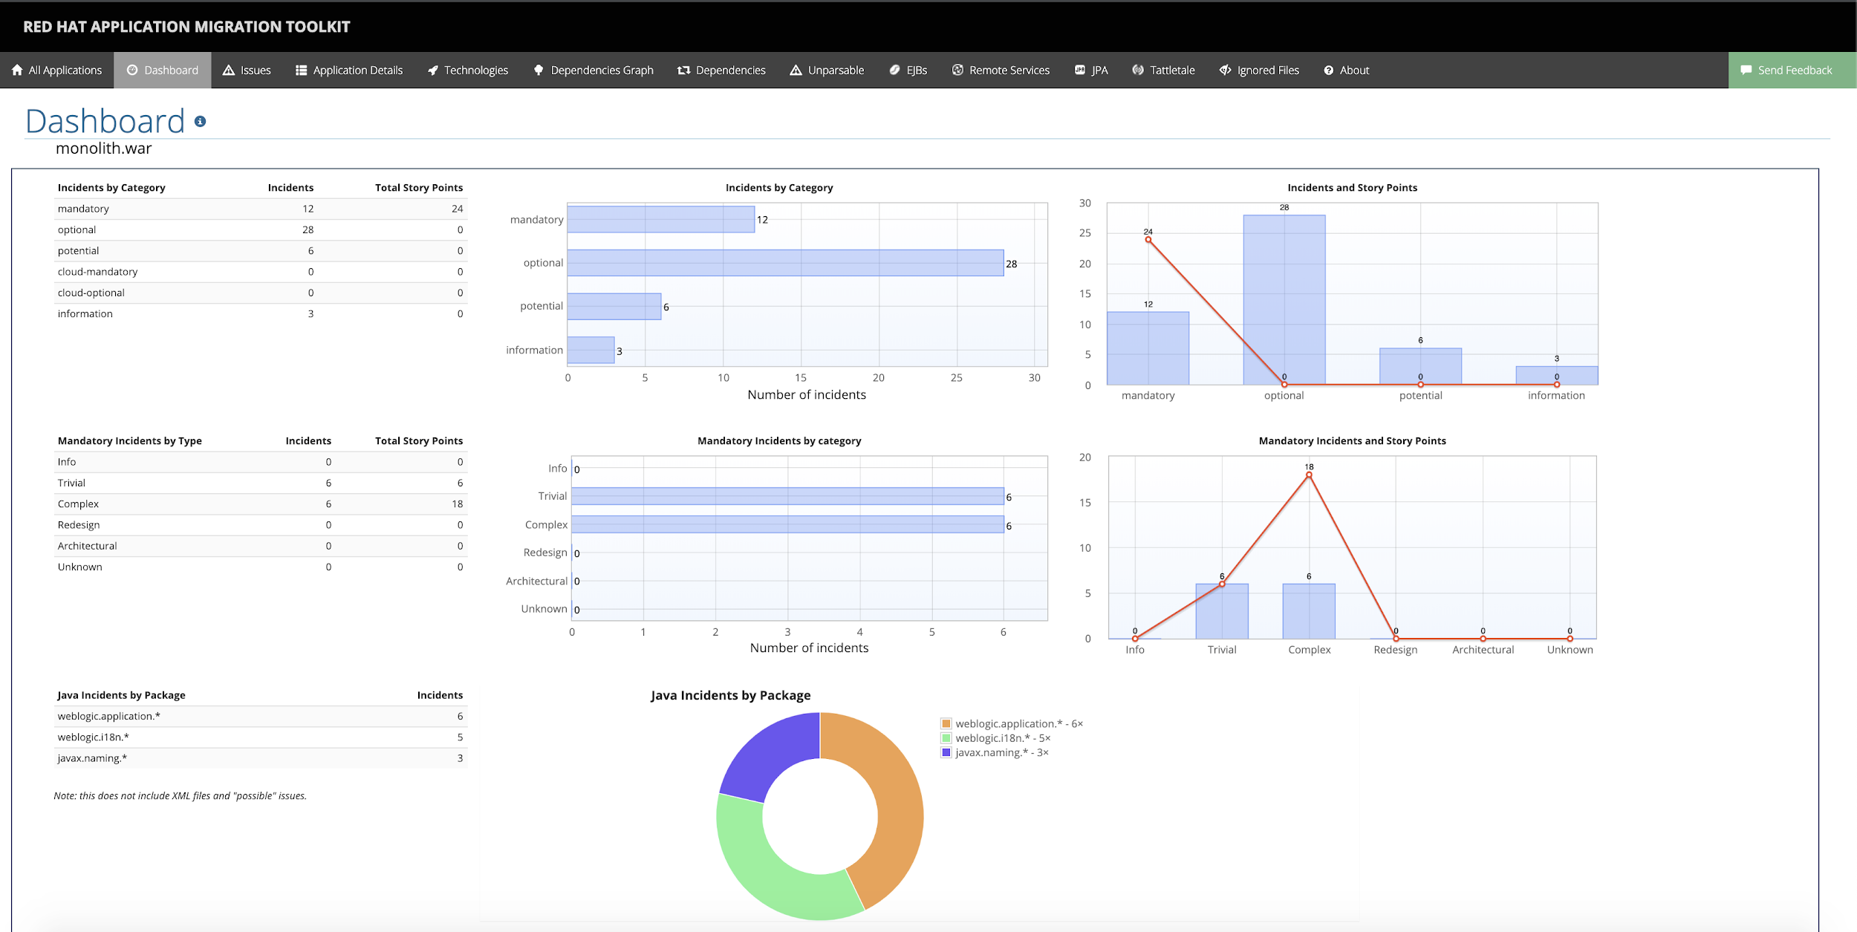
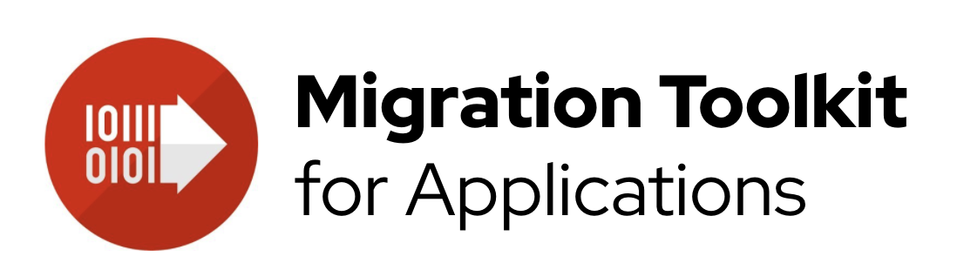
Cool Store Shop
Java EE App on Java EE Server
monolith.war
./mta-web-distribution-<version>/run_mta.sh, http://localhost:8080/mta-ui, jee-example-app-1.0.0.ear

Slide 47
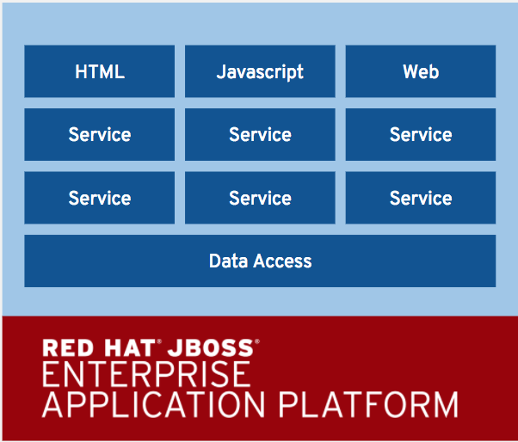

LIFT-AND-SHIFT MONOLITH TO CLOUD
CONTAINER
HTML
Javascript
Web
Service
Service
Service
Service
Service
Service
Data Access

Slide 48







DEPLOY APP BINARY WITH SOURCE-TO-IMAGE (S2I)
build
BUILD APP
(Build Infra)
Application Binary (e.g. WAR)
Existing Build Process
BUILD IMAGE
(OpenShift)
Source-to-Image (S2I)
Builder Image
Image Registry
DEPLOY
(OpenShift)
Application Container
deploy
User/Tool Does
OpenShift Does
Notes:
Blue: OpenShift does Green: User does
Developers use the existing build process and tools (e.g. Maven, Gradle, Jenkins, Nexus) to build the app binaries (e.g. JAR, WAR, EAR) and use OpenShift CLI to create an app from the app binaries
S2I combines app binaries (e.g. JAR, WAR, EAR) with a builder image (language and application runtimes) and stores the resulting application image in the image registry
This image registry by default is the OpenShift integrated docker registry however users can configure S2I to push the built images to third-party registries such as Docker Hub, Nexus, Artifactory, Amazon ECR, Quay, etc.
OpenShift monitors the builder images in the image registry and can automatically rebuild the application images if the language (e.g. Java, Ruby, etc) or application runtime (JBoss EAP, JBoss Web Server, Tomcat, etc) image is updated for example due to security patches.
OpenShift automates the deployment of application containers across multiple hosts via the Kubernetes. Users can trigger deployments, rollback, configure A/B or other custom deployments

Slide 49
STRANGLING THE MONOLITH
‘strangle’ monolith by implementing its services as external microservices, split along business boundaries
As functionality is replaced, “dead” parts of monolith can be removed/retired.
Web
HTML
Javascript
Web
Node.js
Inventory
Catalog
Cart
Promo
Ratings
Orders
Inventory
Catalog
Cart
Data Access
MicroProfile
Spring Boot
Vert.x
JBoss EAP
Orders
Service
Service
Vert.x
Quarkus
Runtime

Slide 50
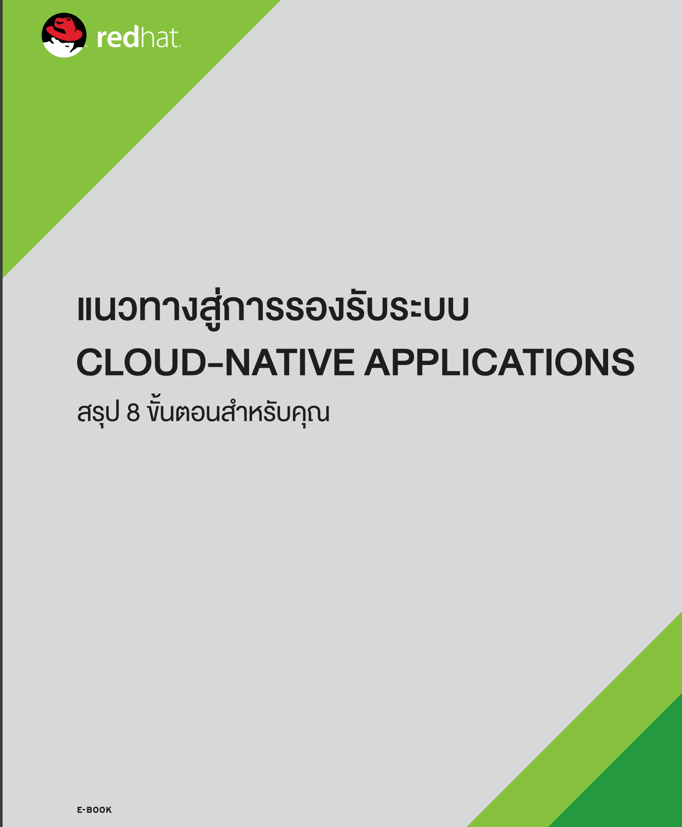

FURTHER EXPLORING

Slide 51
Thank you
Red Hat is the world’s leading provider of enterprise open source software solutions. Award-winning support, training, and consulting services make Red Hat a trusted adviser to the Fortune 500.

